Slide 1

vs
Comparative Analysis of Ride-Share Apps
Presented By :
Prachi Shingvi
Maryam Najiarani
Nivetha Sundar
Calvin Kleber
Mike Strati
Pratik Deshmane

Slide 2
Executive Summary
In our search for a project, our team wanted to focus on the side of data that is related to e-commerce. More specifically we wanted to research,
Businesses that are now a commodity.
Is there competition in this market?
Are there factors that affect these businesses?
Rideshare Apps has changed the Gig Economy for the better. What started as a means to a sustainable side hustle has rapidly grown into a way of life for commuters across the nation. With this as our guiding star (and the available data we could derive from Kaggle!), we decided to embark on the analysis to ultimately decide which Rideshare App was better!

Slide 3
Analysis Flow
Data cleanup process (1 min)
Dive into our analysis (5 min)
General behavior of ride frequency.
Car rides affected by weather conditions.
Rideshare base pricing, revenue and effectiveness of surge pricing.
Commuter behavior (where are they all traveling to and from?)
Our findings in our statistical analysis (1 min)
Our best hypothesis (1 min)
What we found?
Our wins & learnings

Slide 4
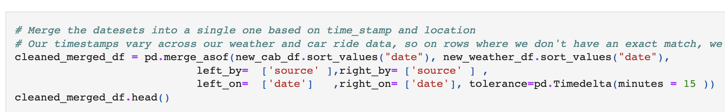
Data Clean-up Process
Dataset sourced from Kaggle
Challenge - Timestamps provided in our weather and car ride csv files were not all identical, so we had to improvise by using a “pandas.merge_asof” function in order to include weather conditions that were within a 15 minute approximation.
Converted timestamps from an epoch format to a regular datetime formatting.
Ensured that milliseconds & seconds in epoch format was adjusted accordingly.
Added day of the week and month for easier grouping functions down the line.
Notes:
Remove unwanted columns, reordered columns for more readability and formatted time_stamp columns on both data csv, then renamed time_stamp to date and location to source

Slide 5
Dive Into Our Analysis

Slide 6
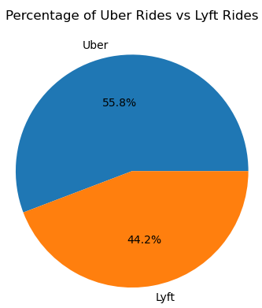
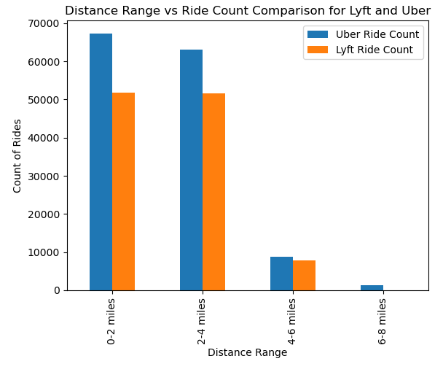
General Behavior of Rideshare Frequency
The rides of Uber and Lyft between the months of November and December.
Rides tend to fit between the ranges of 0-4 miles.

Slide 7
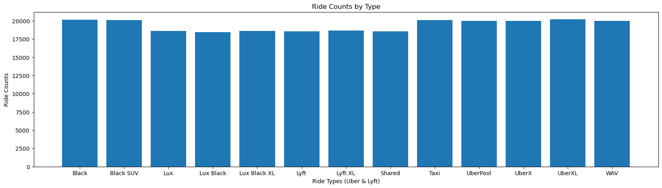
Ride Types & Frequency
Looked at Ride Counts for each Ride Type.
General Observation is count of Lyft rides is lesser than Uber ride types.

Slide 8
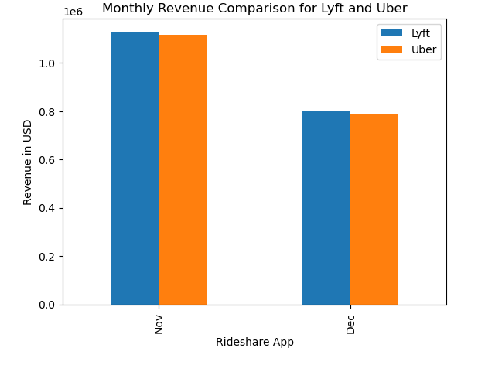
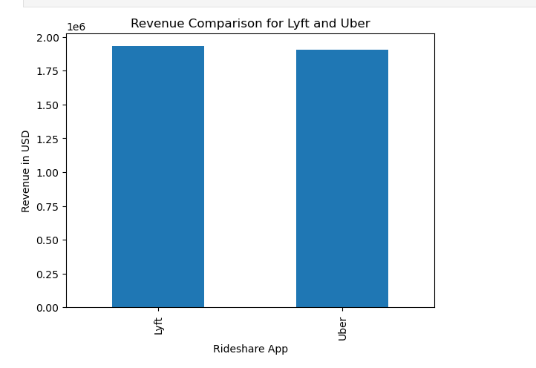
The revenues of Uber and Lyft between the months of November and December.
Although Uber had a higher percentages of rides, Lyft made more revenue.

Slide 9
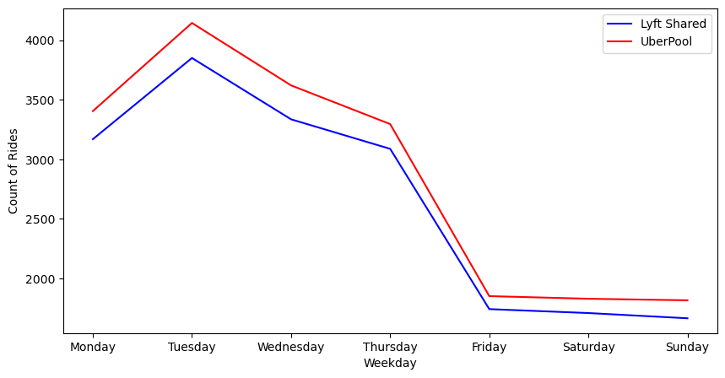
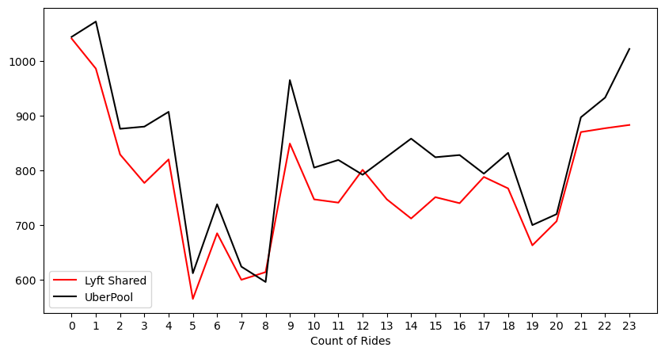
Compared frequency of shared rides for Lyft and Uber by Day of the Week.
We can see that number of shared rides are more at start of the week as compared to weekends

Slide 10
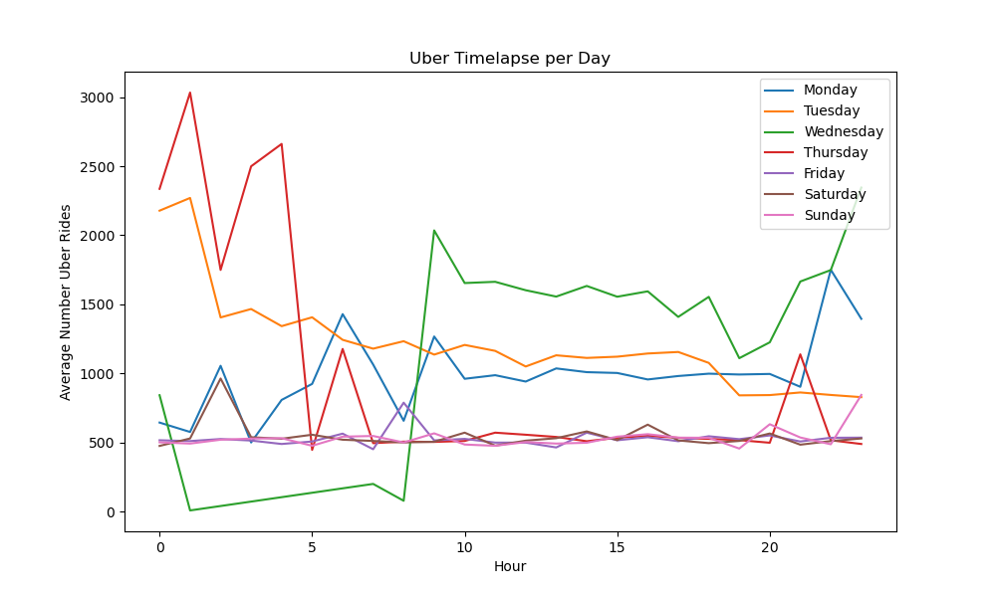
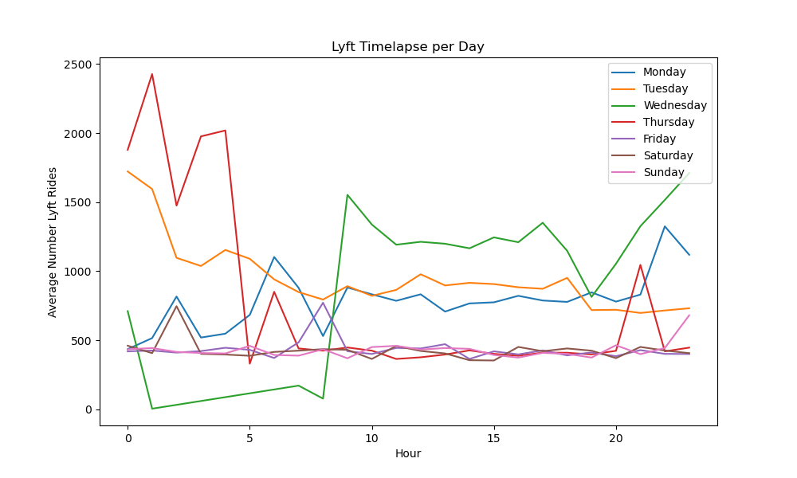

Slide 11
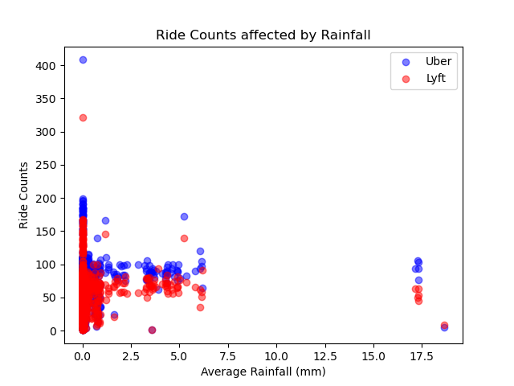
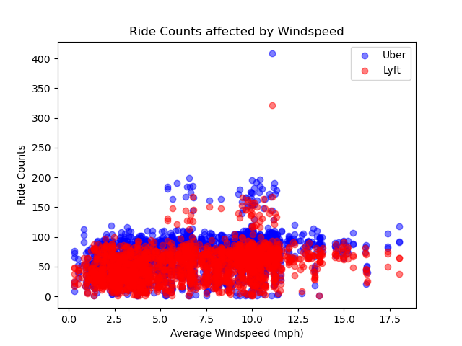
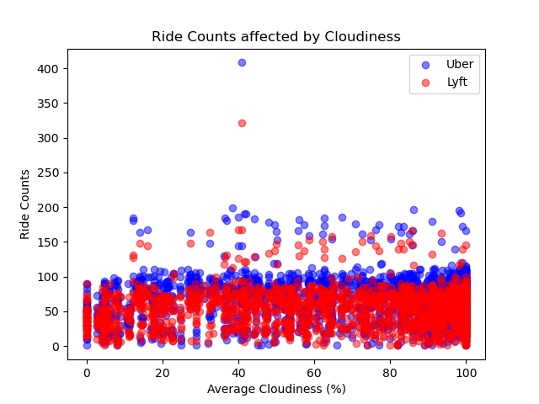
Car Rides Affected by Weather Conditions
While looking at time series between 11/26 & 12/18, Rainfall has a higher peak at the top of our data, whereas cloudiness & windiness remained consistent throughout this timeframe
Knowing that,
Cloudiness and windiness had little to no effect on rides
More rides are taken when rainfall is less!

Slide 12
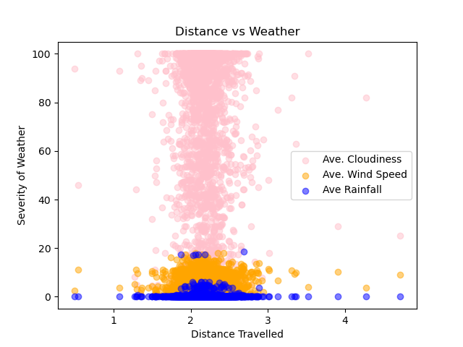
As we found before, the weather data aligns with rideshare frequency. Shorter distances are still prevalent despite these weather conditions.
Commuters aren’t hindered by weather conditions and will still commute to their destination, giving drivers a means to income.

Slide 13
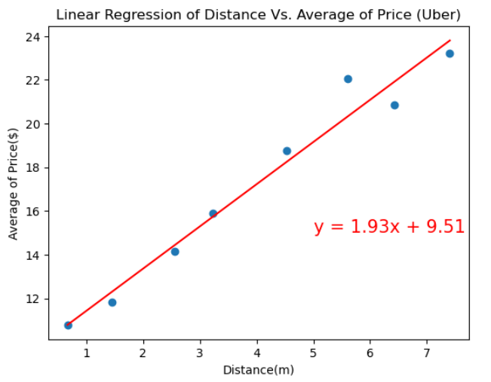
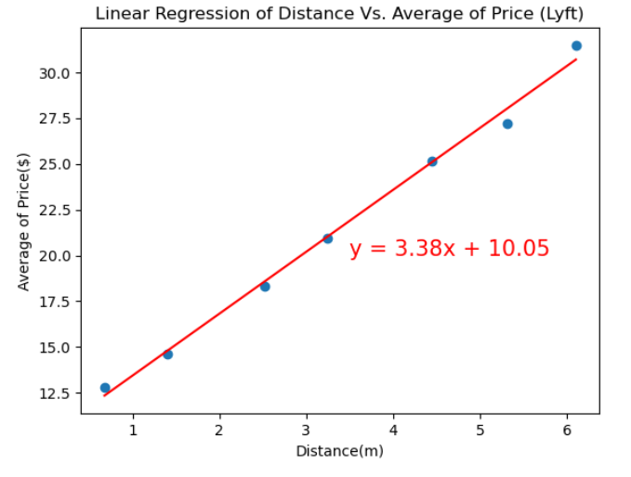
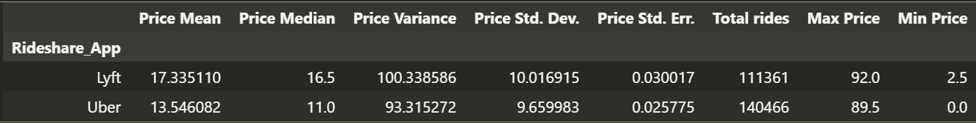
Base Pricing, Revenue and Effectiveness of Surge Pricing
On average, Lyft's prices are higher at $17.34 compared to $13.55 for Uber.
Lyft's initial charges are higher, starting at $10.05, whereas Uber begins at $9.50.
Lyft imposes higher additional charges per mile, amounting to $3.38, as opposed to Uber's lower rate of $1.93.
The average prices for each app on different days of the week remain relatively constant and show minimal fluctuations.
Notes:
In general Lyft is more expensive than Uber, because it charges initially more than Uber almost about a dollar. Lyft charges 1.45 dollars more than Uber for each additional miles , also.

Slide 14
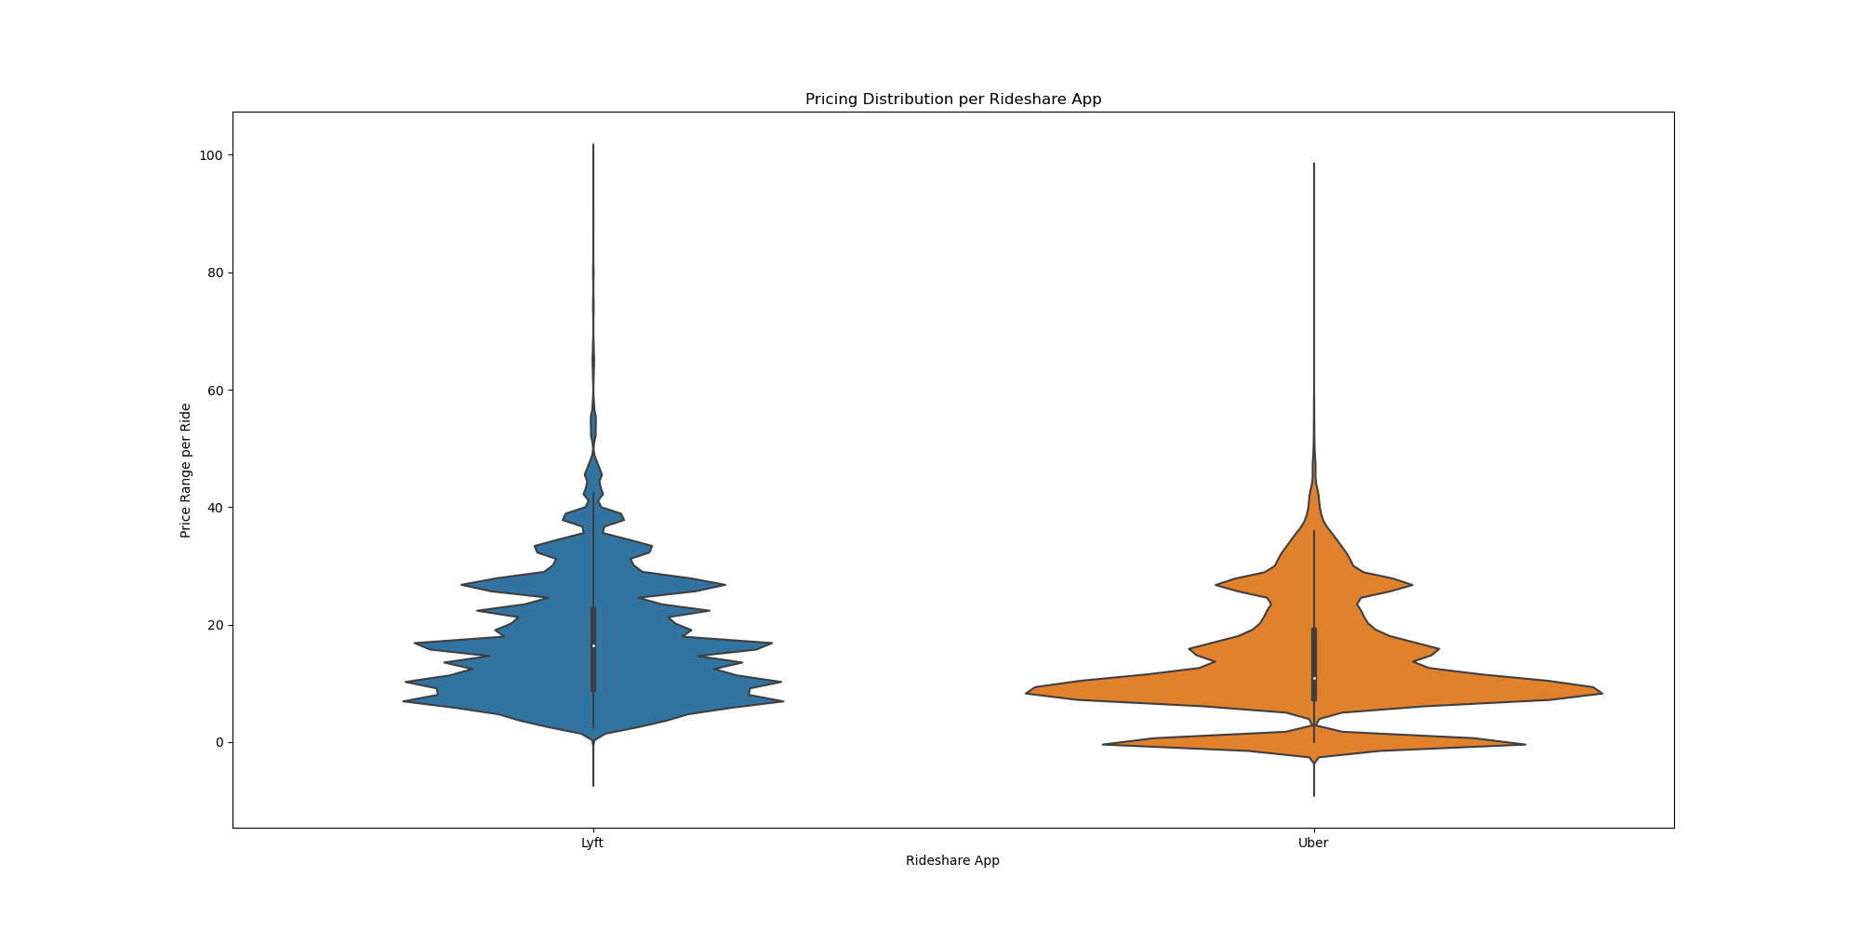
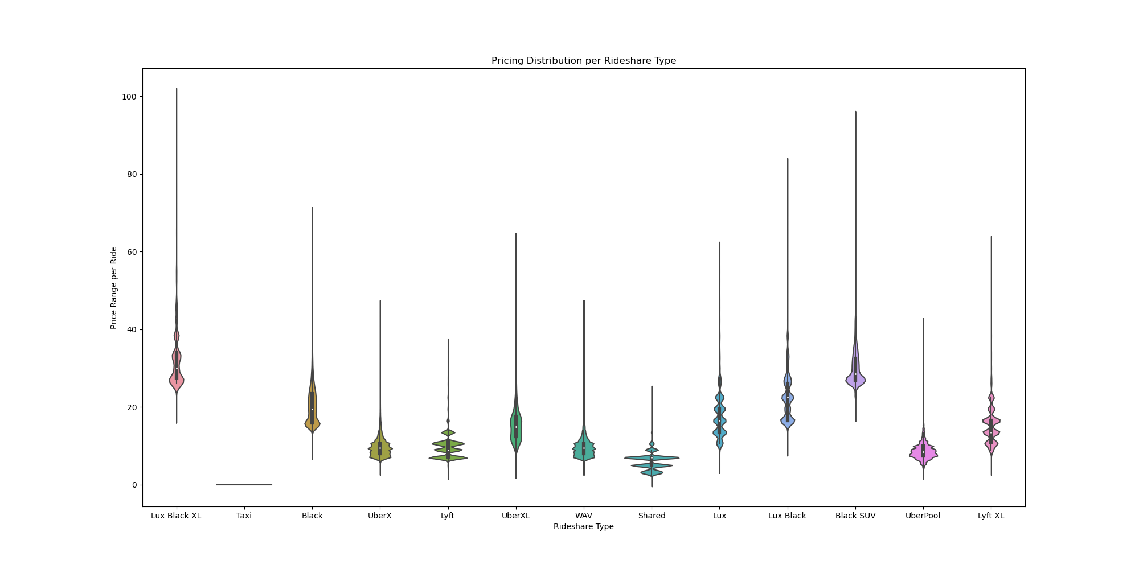
We learned Violin plots.
Mean price of Lyft rides is $17.33
Mean price of Uber rides is $13.54
On analysis on price vs ride types- Black SUV and Lux Black XL are highest among the $ price/ride. Shared and Taxi rides are the cheapest among all ride types.

Slide 15
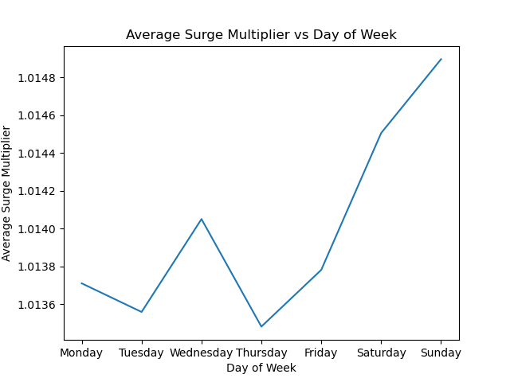
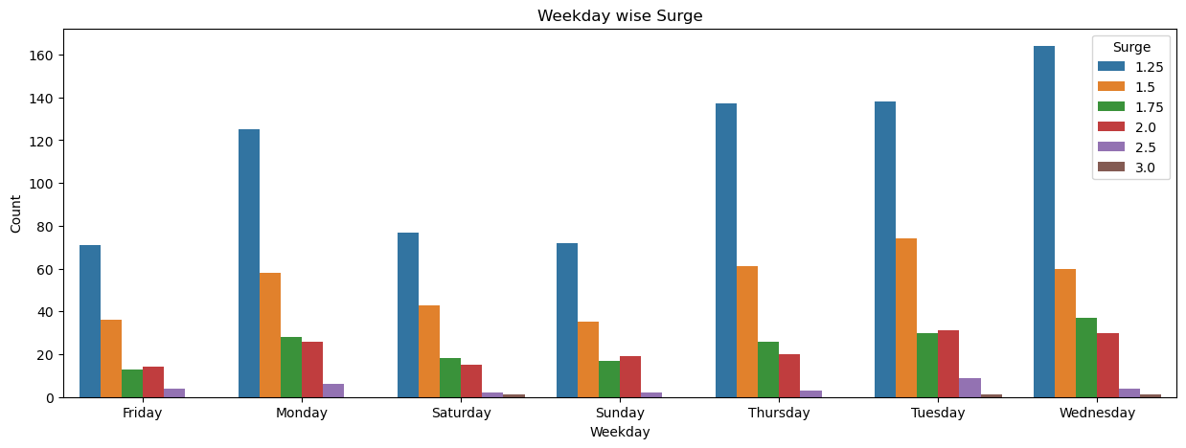
Surge Pricing
Surge happens most on wednesday's and 3.0 Surge multiplier is the less occuring surge multiplier.
In terms of counts vs surge multiplier, Weekends observed less surge in our dataset.
The Max Surge of 3.0 happened only once on Saturday.
On, further analysis for time of the day vs surge multiplier, it was observed that morning and evening time frame are the high surge times of the day.

Slide 16
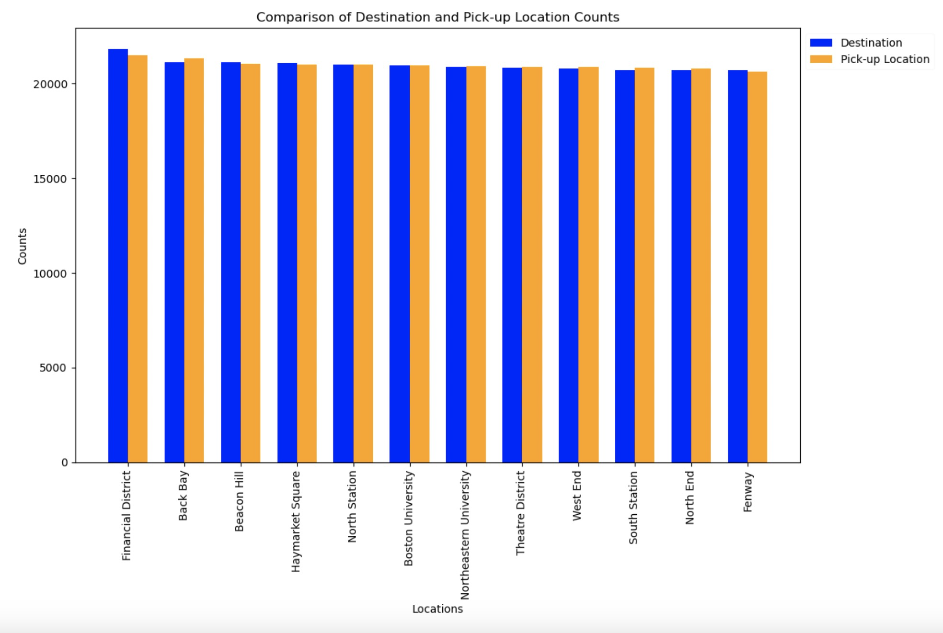
Commuter Behavior (Where is Everyone Going?)
LOCATION // WHERE is everyone going ?
Step 1: First, we gathered out TOTAL COUNTS per LOCATION…
Total Counts: Pick Up Location & Destination
1- Financial District: 42844
2- Haymarket Square: 42578
3- Northeastern University: 42214
4- Beacon Hill: 41989
5- Back Bay: 41951
6- South Station: 41777
7- Theatre District: 41737
8- West End: 41684
9- Boston University: 41870
10- North End: 41722
11- North Station: 41622
12- Fenway: 41666
PICKUP LOCATION COUNTS
1 - PICK-UP LOCATION (Haymarket Square): 21483
2 - PICK-UP LOCATION (Northeastern University): 21339
3 - PICK-UP LOCATION (South Station): 21056
4 - PICK-UP LOCATION (North End): 21010
5 - PICK-UP LOCATION (Financial District): 21002
6 - PICK-UP LOCATION (Fenway): 20971
7 - PICK-UP LOCATION (Boston University): 20914
8 - PICK-UP LOCATION (Theatre District): 20884
9 - PICK-UP LOCATION West End): 20883
10 - PICK-UP LOCATION (Beacon Hill): 20847
11 - PICK-UP LOCATION (Back Bay): 20803
12 - PICK-UP LOCATION (North Station): 20635
DESTINATION COUNTS
1 - DESTINATION (Financial District): 21842
2 - DESTINATION (Back Bay): 21148
3 - DESTINATION (Beacon Hill): 21142
4 - DESTINATION (Haymarket Square): 21095
5 - DESTINATION (North Station): 20987
6 - DESTINATION (Boston University): 20956
7 - DESTINATION (Northeastern University): 20875
8 - DESTINATION (Theatre District): 20853
9 - DESTINATION (West End): 20801
10 - DESTINATION (South Station): 20721
11- DESTINATION (North End): 20712
12 - DESTINATION (Fenway): 20695

Slide 17
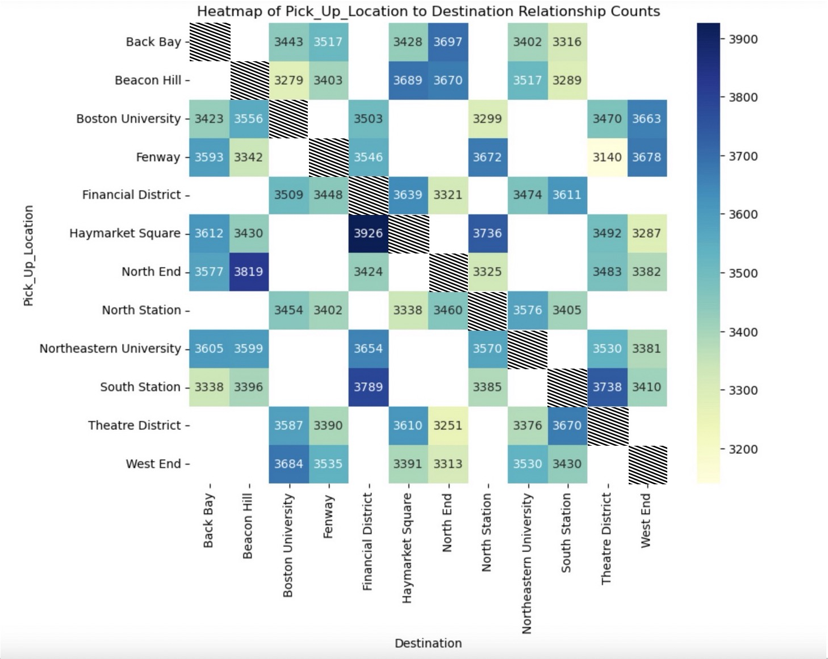
LOCATION // WHERE is everyone going ?
Step 2: Produce a Heatmap of the relationship of Pick Up Location to Destinations.
Analysis: Looking in the Top 10 Pick-Up Location to Destination Relationships, we see a few Locations begin to emerge… -Haymarket Square ( 2x in Top 10 )
-Financial District ( 2x in Top 10 )
-Back Bay ( 2x in Top 10 ) -Beacon Hill ( 3x in Top 10 )
Next, in Step 3: …we plotted TOTAL LOCATION COUNTS to TOTAL REVENUE PER LOCATION…
Top 25 Pick-Up-Location to Destination Relationships
1- Haymarket Square to Financial District: 3926
2- North End to Beacon Hill: 3819
3- South Station to Financial District: 3789
4- Theatre District to Back Bay: 3778
5- Financial District to Haymarket Square: 3639
6- Northeastern University to Back Bay: 3605
7- Fenway to West End: 3593
8- Northeastern University to Beacon Hill: 3599
9- Beacon Hill to North End: 3670
10- Theatre District to South Station: 3670
11- West End to Boston University: 3684
12- North End to Back Bay: 3577
13- Northeastern University to Financial District: 3654
14- Theatre District to Haymarket Square: 3610
15- Haymarket Square to Back Bay: 3612
16- Northeastern University to Theatre District: 3530
17- West End to Northeastern University: 3530
18- Fenway to Financial District: 3546
19- Beacon Hill to Northeastern University: 3517
20- Boston University to West End: 3663
21- Fenway to North Station: 3672
22- Theatre District to Boston University: 3587
23- Fenway to Beacon Hill: 3342
24- South Station to Theatre District: 3738
25- South Station to North Station: 3385

Slide 18
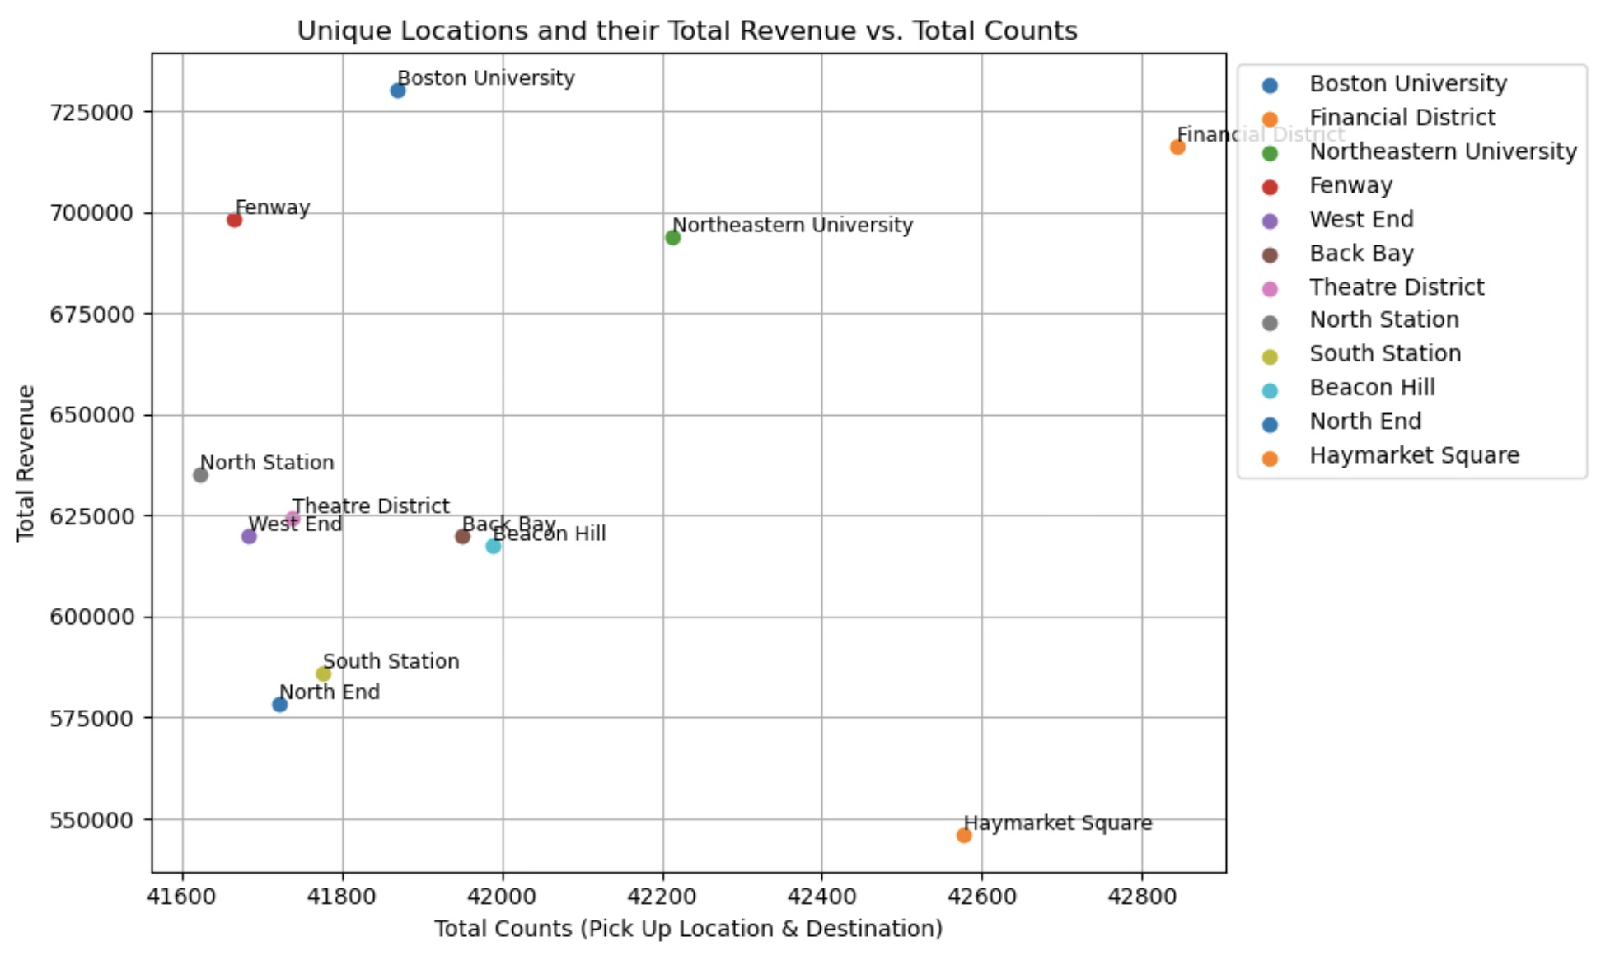
LOCATION // Correlation between LOCATION and REVENUE ?
Step 3: Plot Total Location Counts to Total Revenue Per Location…
Analysis: While Financial District and Northeastern University show a correlation between Total Revenue and Total Rides, Fenway with the 3rd-Highest Revenue and Haymarket Square with the 2nd-Highest Total Rides show little correlation between Total Revenue and Total Rides.
Locations and their Total Revenue:
1- Boston University: $730135.0
2- Financial District: $716308.45
3- Fenway: $698492.5
4- Northeastern University: $694077.0
5- North Station: $635235.0
6- Theatre District: $624418.35
7- Back Bay: $619977.0
8- West End: $619902.85
9- Beacon Hill: $617377.5
10- South Station: $585813.5
11- North End: $578567.0
12- Haymarket Square: $546134.15
Pick_Up_Locations and their Total Revenue
1- Boston University: $364135.0
2- Fenway: $355545.0
3- Financial District: $352729.45
4- Northeastern University: $352192.0
5- Theatre District: $318737.85
6- North Station: $311110.5
7- Back Bay: $305955.0
8- South Station: $301651.5
9- Beacon Hill: $300966.0
10- West End: $309071.85
11- North End: $292112.0
12- Haymarket Square: $269013.0
Destinations and their Total Revenue
1- Boston University: $366000.0
2- Financial District: $363579.0
3- Fenway: $342947.5
4- Northeastern University: $341885.0
5- North Station: $324124.5
6- Beacon Hill: $316411.5
7- Back Bay: $314022.0
8- West End: $310831.0
9- Theatre District: $305680.5
10- North End: $286455.0
11- South Station: $284162.0
12- Haymarket Square: $277121.15

Slide 19
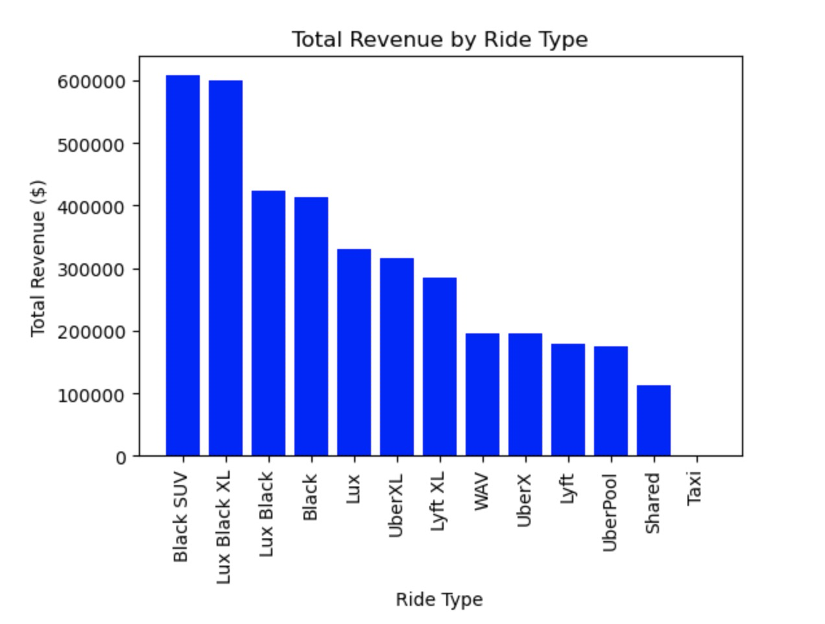
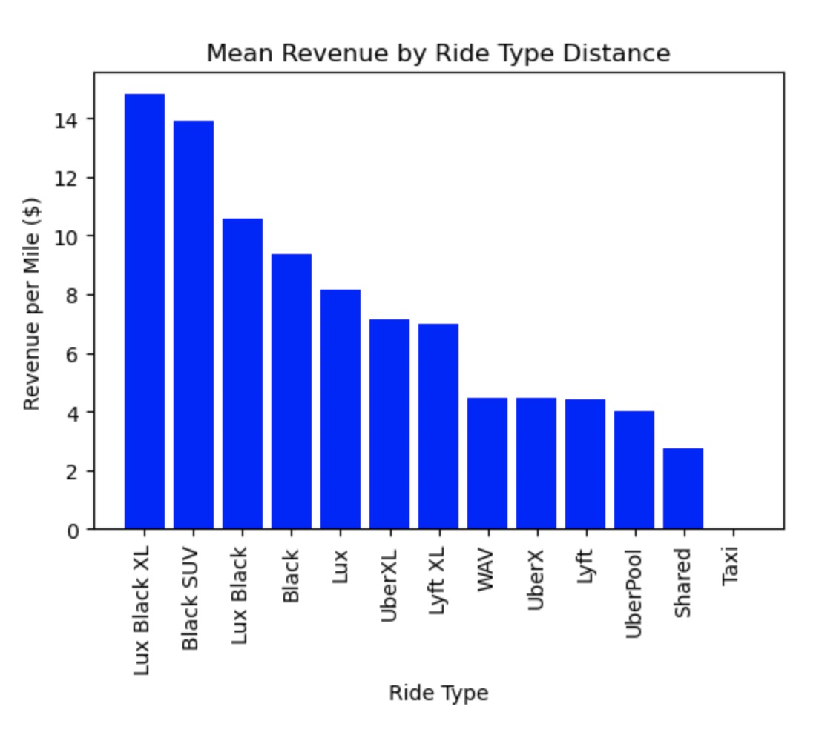
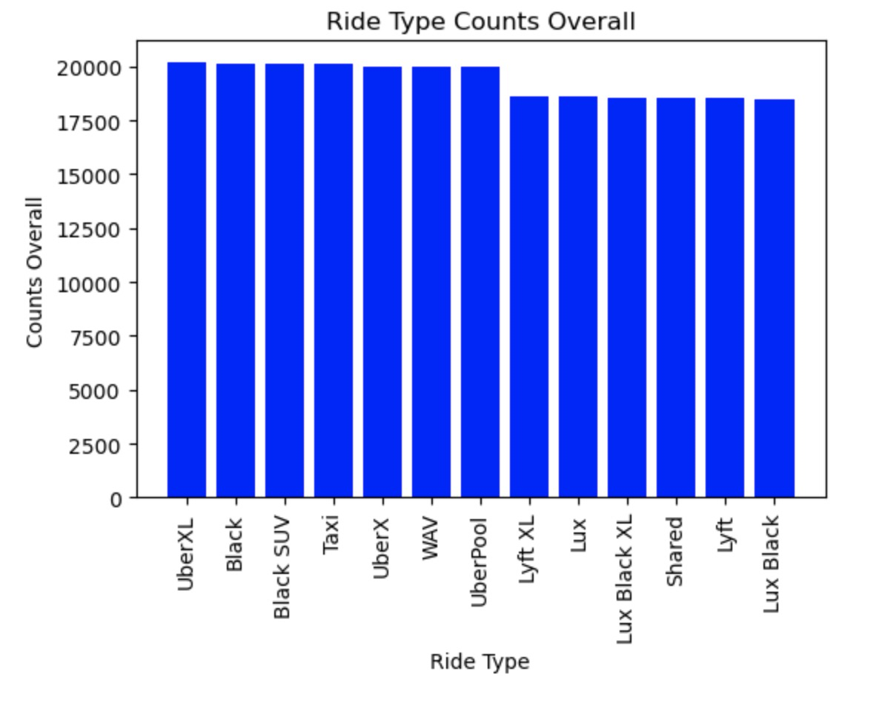
COMPARING RIDE TYPES // RIDE COUNTS OVERALL // REVENUE by RIDE TYPE // REVENUE per MILE
Step 1: gather data for RIDE COUNTS OVERALL, REVENUE by RIDE TYPE, REVENUE per MILE ( below )
RIDE TYPE COUNTS OVERALL
1 - RIDE_TYPE NAME (UberXL): 20197
2 - RIDE_TYPE NAME (Black): 20125
3 - RIDE_TYPE NAME (Black SUV): 20109
4 - RIDE_TYPE NAME (Taxi): 20098
5 - RIDE_TYPE NAME (UberX): 19994
6 - RIDE_TYPE NAME (WAV): 19980
7 - RIDE_TYPE NAME (UberPool): 19963
8 - RIDE_TYPE NAME (Lyft XL): 18644
9 - RIDE_TYPE NAME (Lux): 18586
10 - RIDE_TYPE NAME (Lux Black XL): 18579
11 - RIDE_TYPE NAME (Shared): 18560
12 - RIDE_TYPE NAME (Lyft): 18534
13 - RIDE_TYPE NAME (Lux Black): 18458
TOTAL REVENUE by RIDE TYPE
1- Black SUV: $607,876.50
2- Lux Black XL: $600,229.50
3- Lux Black: $424,461.20
4- Black: $412,885.00
5- Lux: $330,299.00
6- UberXL: $316,497.50
7- Lyft XL: $285,467.10
8- WAV: $195,575.00
9- UberX: $195,537.00
10- Lyft: $178,235.35
11- UberPool: $174,393.00
12- Shared: $111,763.00
13- Taxi: $0.00 / (n/a)
MEAN REVENUE by RIDE TYPE DISTANCE
1- Lux Black XL: $14.82 / mile
2- Black SUV: $13.89 / mile
3- Lux Black: $10.57 / mile
4- Black: $9.37 / mile
5- Lux: $8.14 / mile
6- UberXL: $7.16 / mile
7- Lyft XL: $7.01 / mile
8- WAV: $4.45 / mile
9- UberX: $4.48 / mile
10- Lyft: $4.40 / mile
11- UberPool: $4.01 / mile
12- Shared: $2.76 / mile
13- Taxi: $0.00 / mile / (n/a)

Slide 20
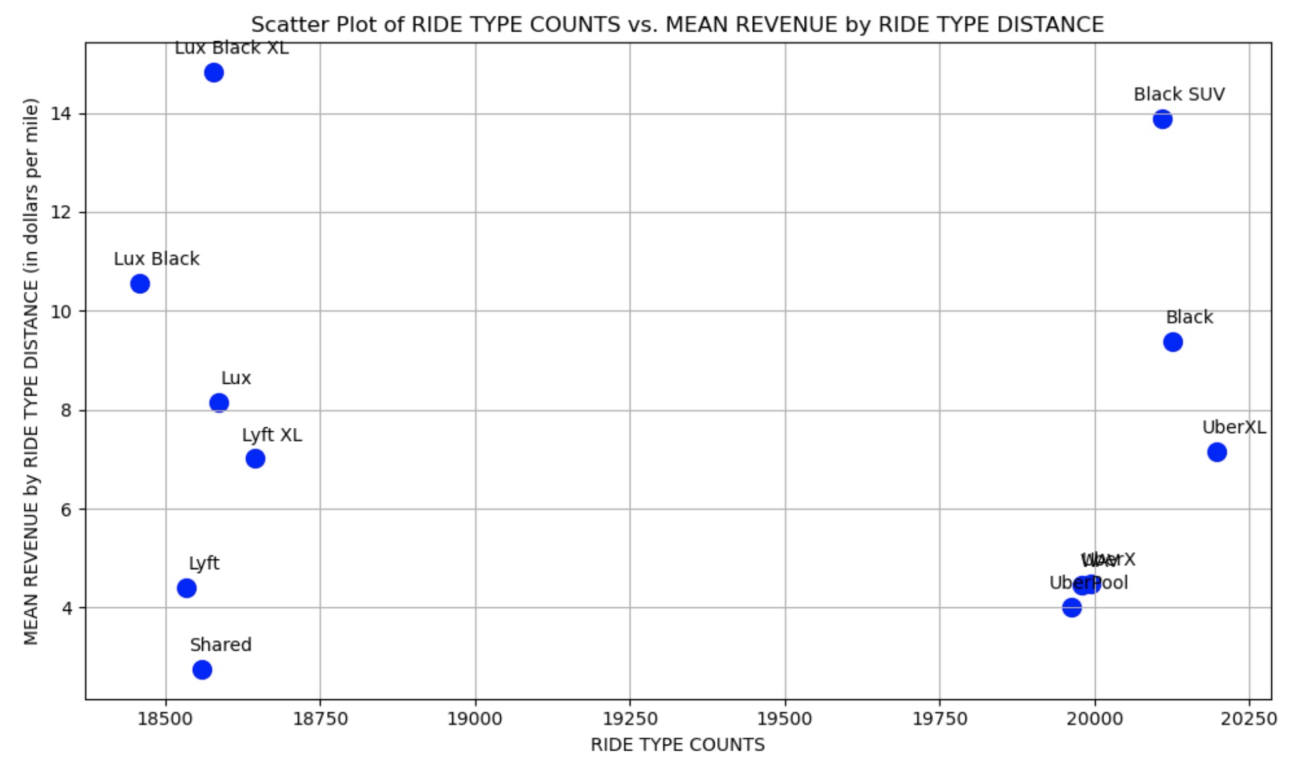
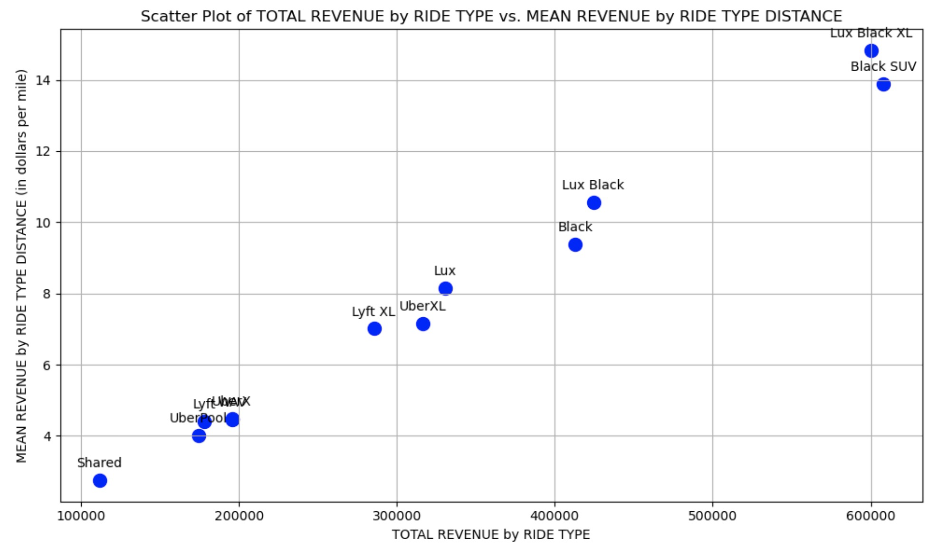
COMPARING RIDE TYPES
RIDE TYPE COUNTS OVERALL
1 - RIDE_TYPE NAME (UberXL): 20197
2 - RIDE_TYPE NAME (Black): 20125
3 - RIDE_TYPE NAME (Black SUV): 20109
4 - RIDE_TYPE NAME (Taxi): 20098
5 - RIDE_TYPE NAME (UberX): 19994
6 - RIDE_TYPE NAME (WAV): 19980
7 - RIDE_TYPE NAME (UberPool): 19963
8 - RIDE_TYPE NAME (Lyft XL): 18644
9 - RIDE_TYPE NAME (Lux): 18586
10 - RIDE_TYPE NAME (Lux Black XL): 18579
11 - RIDE_TYPE NAME (Shared): 18560
12 - RIDE_TYPE NAME (Lyft): 18534
13 - RIDE_TYPE NAME (Lux Black): 18458
TOTAL REVENUE by RIDE TYPE
1- Black SUV: $607,876.50
2- Lux Black XL: $600,229.50
3- Lux Black: $424,461.20
4- Black: $412,885.00
5- Lux: $330,299.00
6- UberXL: $316,497.50
7- Lyft XL: $285,467.10
8- WAV: $195,575.00
9- UberX: $195,537.00
10- Lyft: $178,235.35
11- UberPool: $174,393.00
12- Shared: $111,763.00
13- Taxi: $0.00
MEAN REVENUE by RIDE TYPE DISTANCE
1- Lux Black XL: $14.82 / mile
2- Black SUV: $13.89 / mile
3- Lux Black: $10.57 / mile
4- Black: $9.37 / mile
5- Lux: $8.14 / mile
6- UberXL: $7.16 / mile
7- Lyft XL: $7.01 / mile
8- WAV: $4.45 / mile
9- UberX: $4.48 / mile
10- Lyft: $4.40 / mile
11- UberPool: $4.01 / mile
12- Shared: $2.76 / mile
13- Taxi: $0.00 / mile
Whereas… RIDE TYPE COUNTS -to- REVENUE per MILE …shows a divergent relationship… TOTAL REVENUE -to- REVENUE per MILE …shows a direct trend…

Slide 21
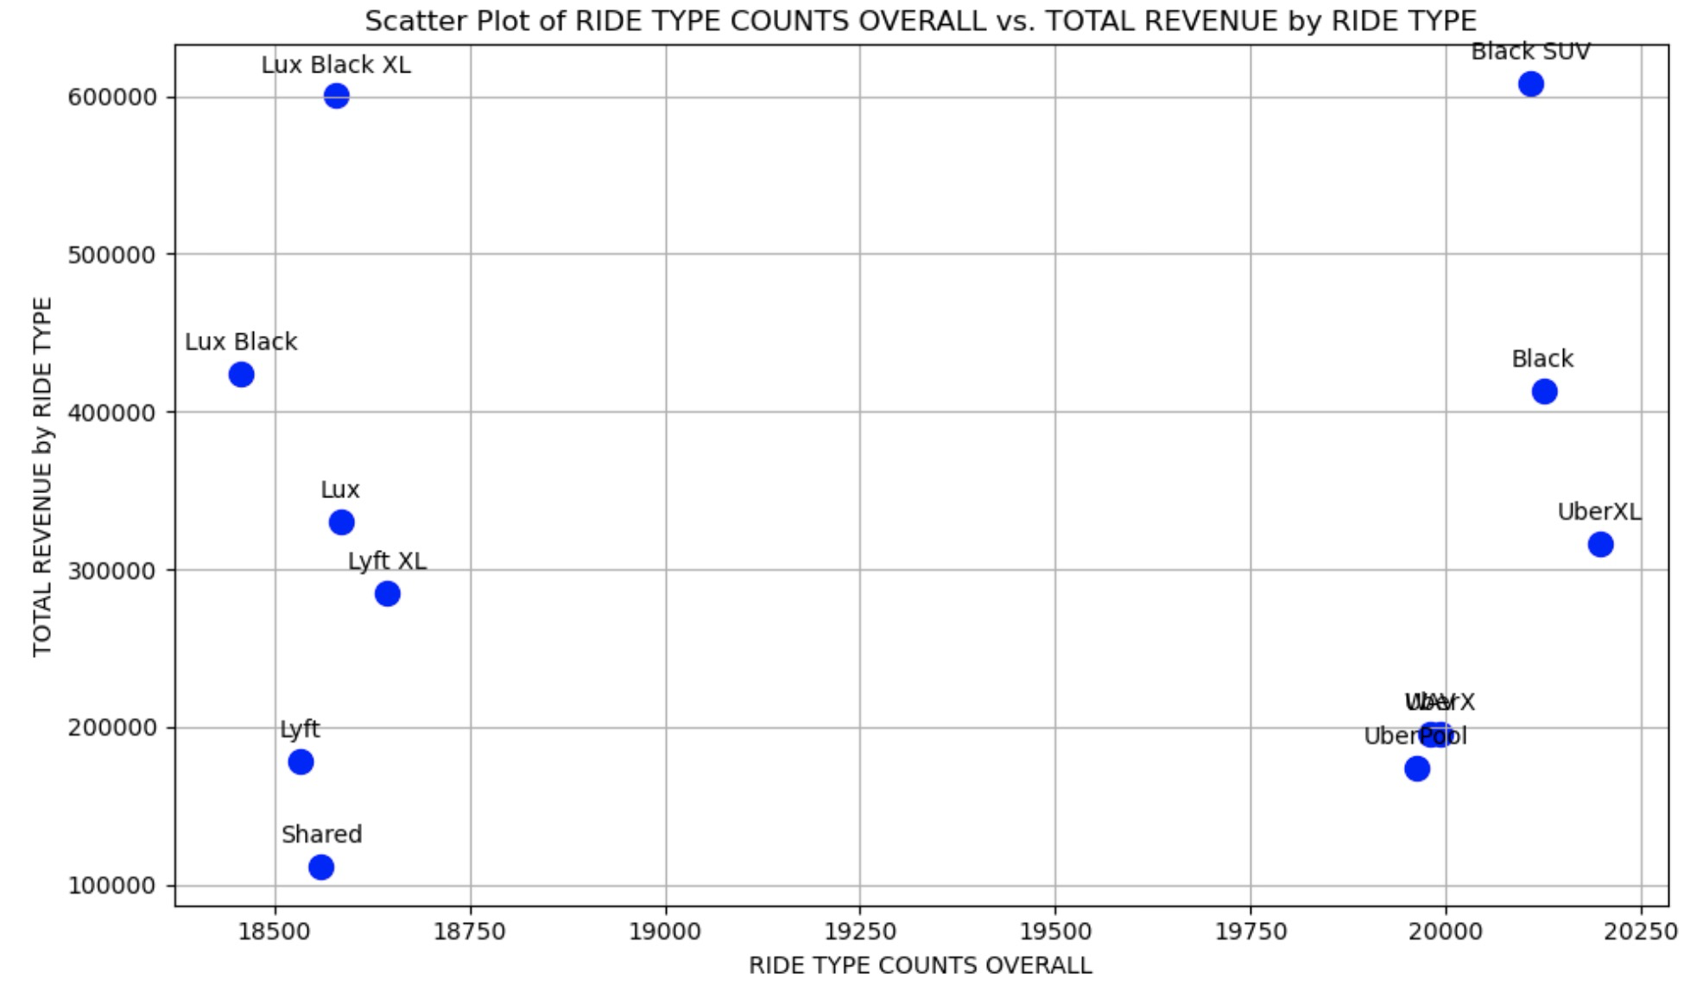
RIDE TYPE COUNTS OVERALL
1 - RIDE_TYPE NAME (UberXL): 20197
2 - RIDE_TYPE NAME (Black): 20125
3 - RIDE_TYPE NAME (Black SUV): 20109
4 - RIDE_TYPE NAME (Taxi): 20098
5 - RIDE_TYPE NAME (UberX): 19994
6 - RIDE_TYPE NAME (WAV): 19980
7 - RIDE_TYPE NAME (UberPool): 19963
8 - RIDE_TYPE NAME (Lyft XL): 18644
9 - RIDE_TYPE NAME (Lux): 18586
10 - RIDE_TYPE NAME (Lux Black XL): 18579
11 - RIDE_TYPE NAME (Shared): 18560
12 - RIDE_TYPE NAME (Lyft): 18534
13 - RIDE_TYPE NAME (Lux Black): 18458
TOTAL REVENUE by RIDE TYPE
1- Black SUV: $607,876.50
2- Lux Black XL: $600,229.50
3- Lux Black: $424,461.20
4- Black: $412,885.00
5- Lux: $330,299.00
6- UberXL: $316,497.50
7- Lyft XL: $285,467.10
8- WAV: $195,575.00
9- UberX: $195,537.00
10- Lyft: $178,235.35
11- UberPool: $174,393.00
12- Shared: $111,763.00
13- Taxi: $0.00
…and… RIDE TYPE COUNTS -to- TOTAL REVENUE …shows the similar divergent relationship… Next Slide: let’s take a look at 3 RIDE TYPE Case Studies to highlight these relationships…

Slide 22
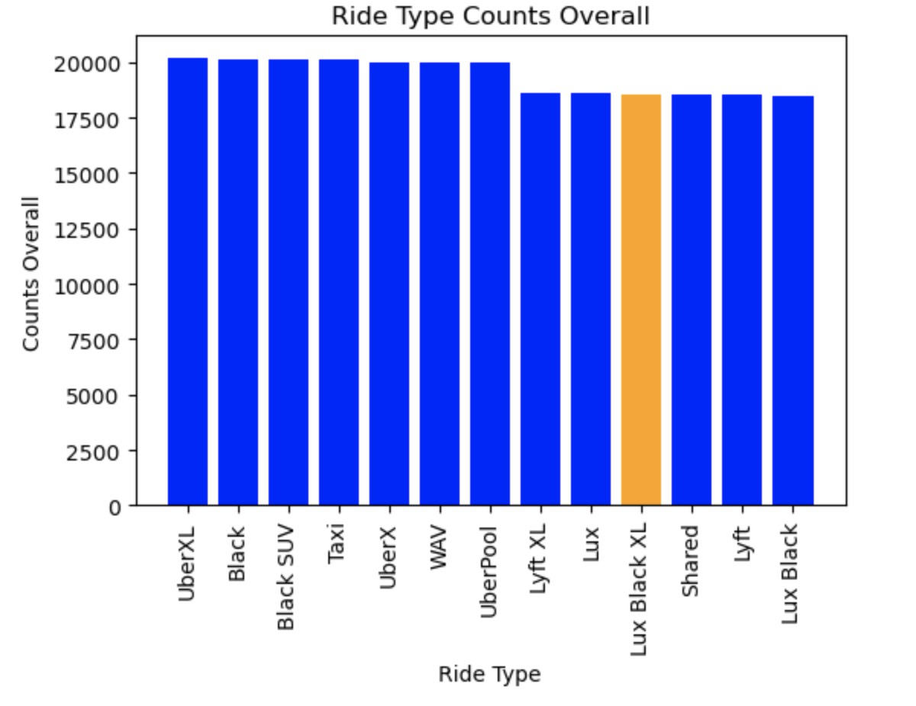
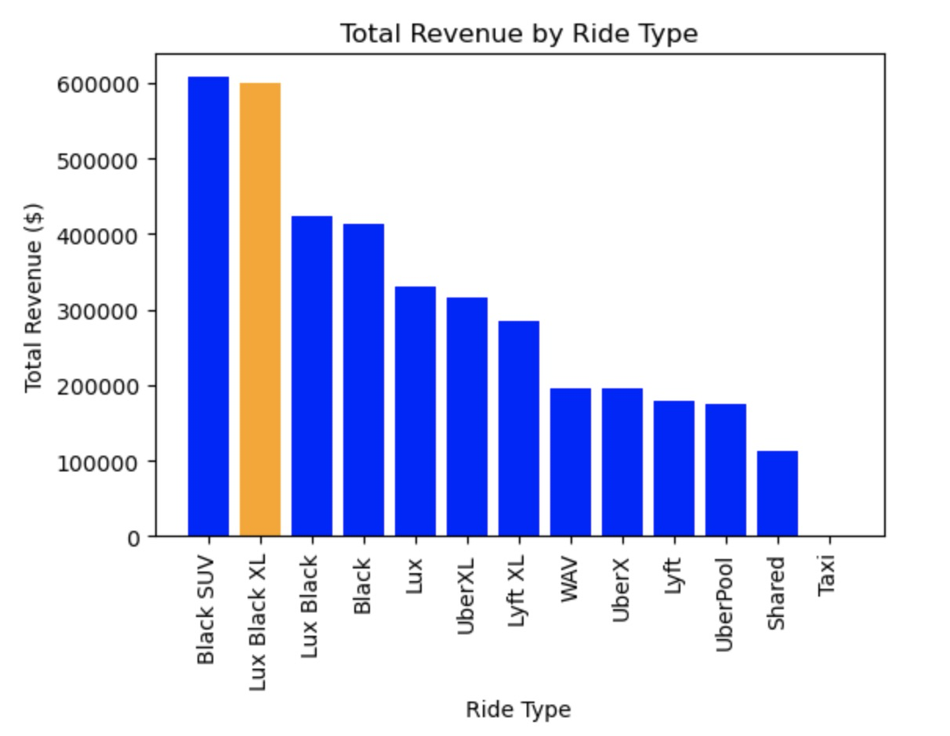
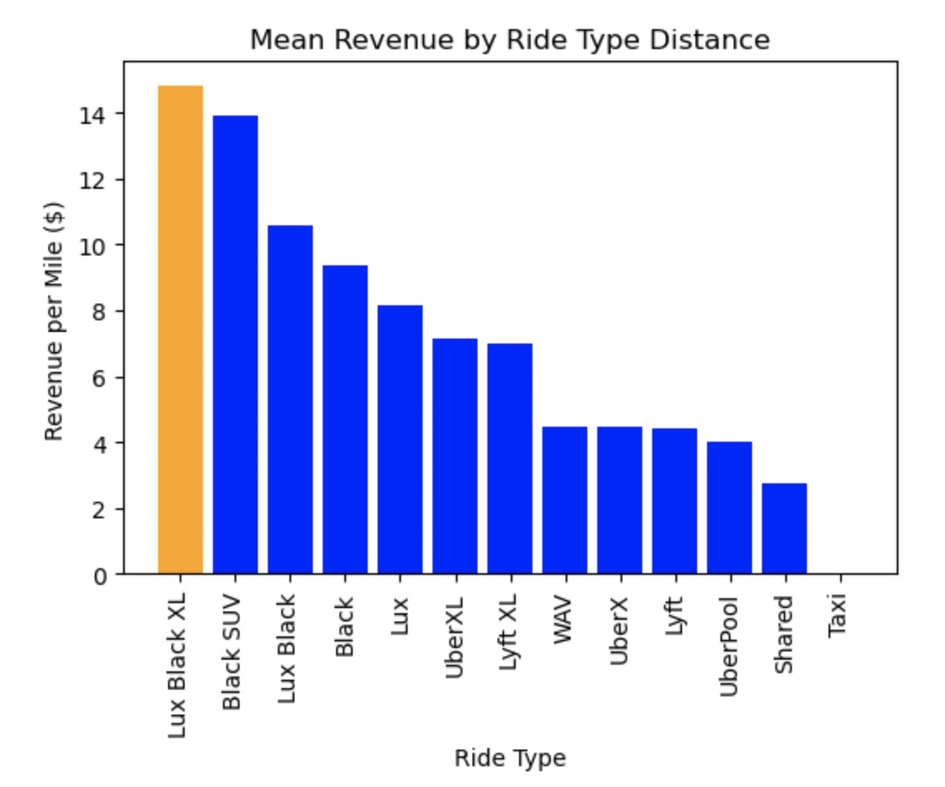
The Story of: [1] Lux Black XL - $14.82 per mile // [2] Black SUV - $13.89 per mile // [3] Lux Black - $10.57 per mile
RIDE TYPE COUNTS OVERALL
1 - RIDE_TYPE NAME (UberXL): 20197
2 - RIDE_TYPE NAME (Black): 20125
3 - RIDE_TYPE NAME (Black SUV): 20109
4 - RIDE_TYPE NAME (Taxi): 20098
5 - RIDE_TYPE NAME (UberX): 19994
6 - RIDE_TYPE NAME (WAV): 19980
7 - RIDE_TYPE NAME (UberPool): 19963
8 - RIDE_TYPE NAME (Lyft XL): 18644
9 - RIDE_TYPE NAME (Lux): 18586
10 - RIDE_TYPE NAME (Lux Black XL): 18579
11 - RIDE_TYPE NAME (Shared): 18560
12 - RIDE_TYPE NAME (Lyft): 18534
13 - RIDE_TYPE NAME (Lux Black): 18458
TOTAL REVENUE by RIDE TYPE
1- Black SUV: $607,876.50
2- Lux Black XL: $600,229.50
3- Lux Black: $424,461.20
4- Black: $412,885.00
5- Lux: $330,299.00
6- UberXL: $316,497.50
7- Lyft XL: $285,467.10
8- WAV: $195,575.00
9- UberX: $195,537.00
10- Lyft: $178,235.35
11- UberPool: $174,393.00
12- Shared: $111,763.00
13- Taxi: $0.00
MEAN REVENUE by RIDE TYPE DISTANCE
1- Lux Black XL: $14.82 / mile
2- Black SUV: $13.89 / mile
3- Lux Black: $10.57 / mile
4- Black: $9.37 / mile
5- Lux: $8.14 / mile
6- UberXL: $7.16 / mile
7- Lyft XL: $7.01 / mile
8- WAV: $4.45 / mile
9- UberX: $4.48 / mile
10- Lyft: $4.40 / mile
11- UberPool: $4.01 / mile
12- Shared: $2.76 / mile
13- Taxi: $0.00 / mile

Slide 23
The Story of: Lux Black XL [ HIGHLIGHT - 1- Lux Black XL: $14.82 / mile ]
RIDE TYPE COUNTS OVERALL
1 - RIDE_TYPE NAME (UberXL): 20197
2 - RIDE_TYPE NAME (Black): 20125
3 - RIDE_TYPE NAME (Black SUV): 20109
4 - RIDE_TYPE NAME (Taxi): 20098
5 - RIDE_TYPE NAME (UberX): 19994
6 - RIDE_TYPE NAME (WAV): 19980
7 - RIDE_TYPE NAME (UberPool): 19963
8 - RIDE_TYPE NAME (Lyft XL): 18644
9 - RIDE_TYPE NAME (Lux): 18586
10 - RIDE_TYPE NAME (Lux Black XL): 18579
11 - RIDE_TYPE NAME (Shared): 18560
12 - RIDE_TYPE NAME (Lyft): 18534
13 - RIDE_TYPE NAME (Lux Black): 18458
TOTAL REVENUE by RIDE TYPE
1- Black SUV: $607,876.50
2- Lux Black XL: $600,229.50
3- Lux Black: $424,461.20
4- Black: $412,885.00
5- Lux: $330,299.00
6- UberXL: $316,497.50
7- Lyft XL: $285,467.10
8- WAV: $195,575.00
9- UberX: $195,537.00
10- Lyft: $178,235.35
11- UberPool: $174,393.00
12- Shared: $111,763.00
13- Taxi: $0.00
MEAN REVENUE by RIDE TYPE DISTANCE
1- Lux Black XL: $14.82 / mile
2- Black SUV: $13.89 / mile
3- Lux Black: $10.57 / mile
4- Black: $9.37 / mile
5- Lux: $8.14 / mile
6- UberXL: $7.16 / mile
7- Lyft XL: $7.01 / mile
8- WAV: $4.45 / mile
9- UberX: $4.48 / mile
10- Lyft: $4.40 / mile
11- UberPool: $4.01 / mile
12- Shared: $2.76 / mile
13- Taxi: $0.00 / mile

Slide 24
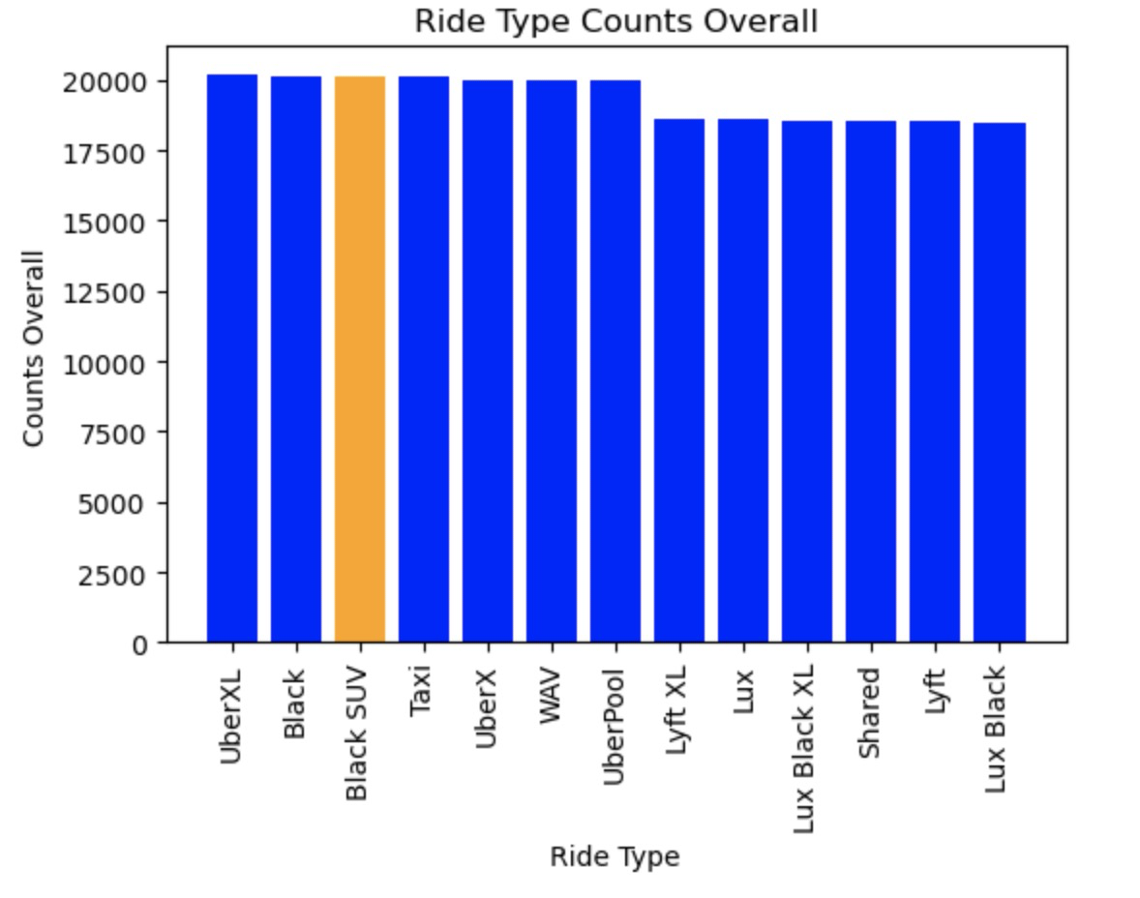
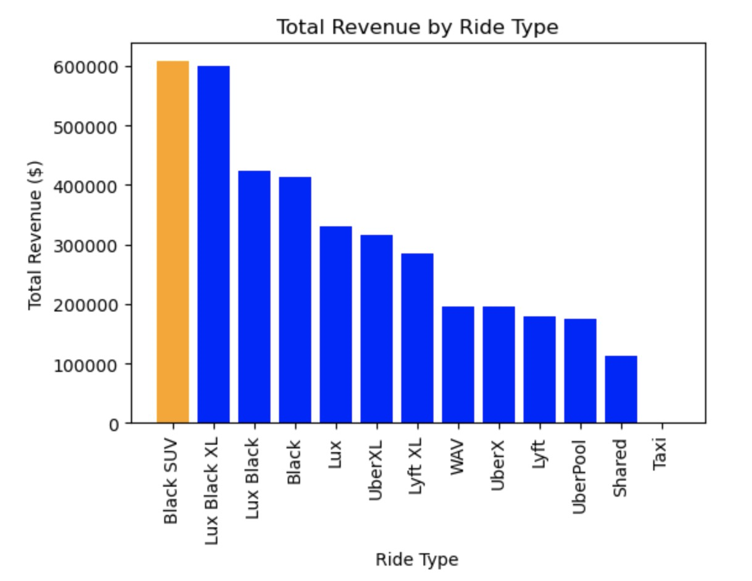
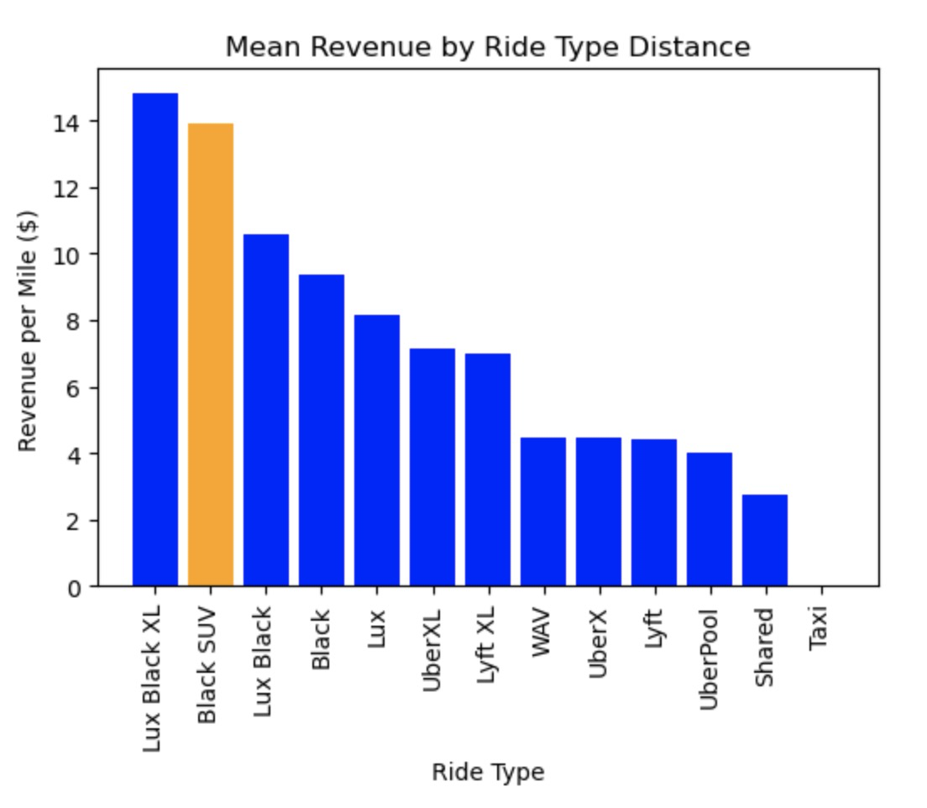
The Story of: BLACK SUV ( uber ) - [ HIGHLIGHT - 2 - Black SUV: $13.89 / mile ]
RIDE TYPE COUNTS OVERALL
1 - RIDE_TYPE NAME (UberXL): 20197
2 - RIDE_TYPE NAME (Black): 20125
3 - RIDE_TYPE NAME (Black SUV): 20109
4 - RIDE_TYPE NAME (Taxi): 20098
5 - RIDE_TYPE NAME (UberX): 19994
6 - RIDE_TYPE NAME (WAV): 19980
7 - RIDE_TYPE NAME (UberPool): 19963
8 - RIDE_TYPE NAME (Lyft XL): 18644
9 - RIDE_TYPE NAME (Lux): 18586
10 - RIDE_TYPE NAME (Lux Black XL): 18579
11 - RIDE_TYPE NAME (Shared): 18560
12 - RIDE_TYPE NAME (Lyft): 18534
13 - RIDE_TYPE NAME (Lux Black): 18458
TOTAL REVENUE by RIDE TYPE
1- Black SUV: $607,876.50
2- Lux Black XL: $600,229.50
3- Lux Black: $424,461.20
4- Black: $412,885.00
5- Lux: $330,299.00
6- UberXL: $316,497.50
7- Lyft XL: $285,467.10
8- WAV: $195,575.00
9- UberX: $195,537.00
10- Lyft: $178,235.35
11- UberPool: $174,393.00
12- Shared: $111,763.00
13- Taxi: $0.00
MEAN REVENUE by RIDE TYPE DISTANCE
1- Lux Black XL: $14.82 / mile
2- Black SUV: $13.89 / mile
3- Lux Black: $10.57 / mile
4- Black: $9.37 / mile
5- Lux: $8.14 / mile
6- UberXL: $7.16 / mile
7- Lyft XL: $7.01 / mile
8- WAV: $4.45 / mile
9- UberX: $4.48 / mile
10- Lyft: $4.40 / mile
11- UberPool: $4.01 / mile
12- Shared: $2.76 / mile
13- Taxi: $0.00 / mile

Slide 25
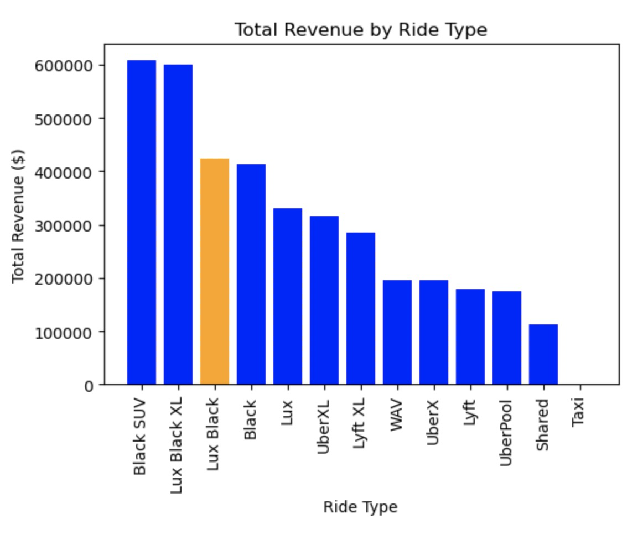
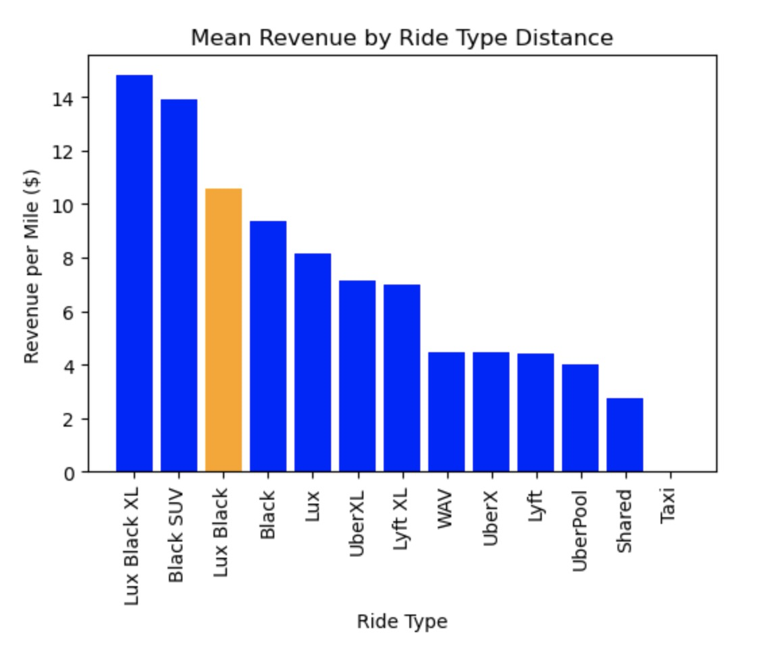
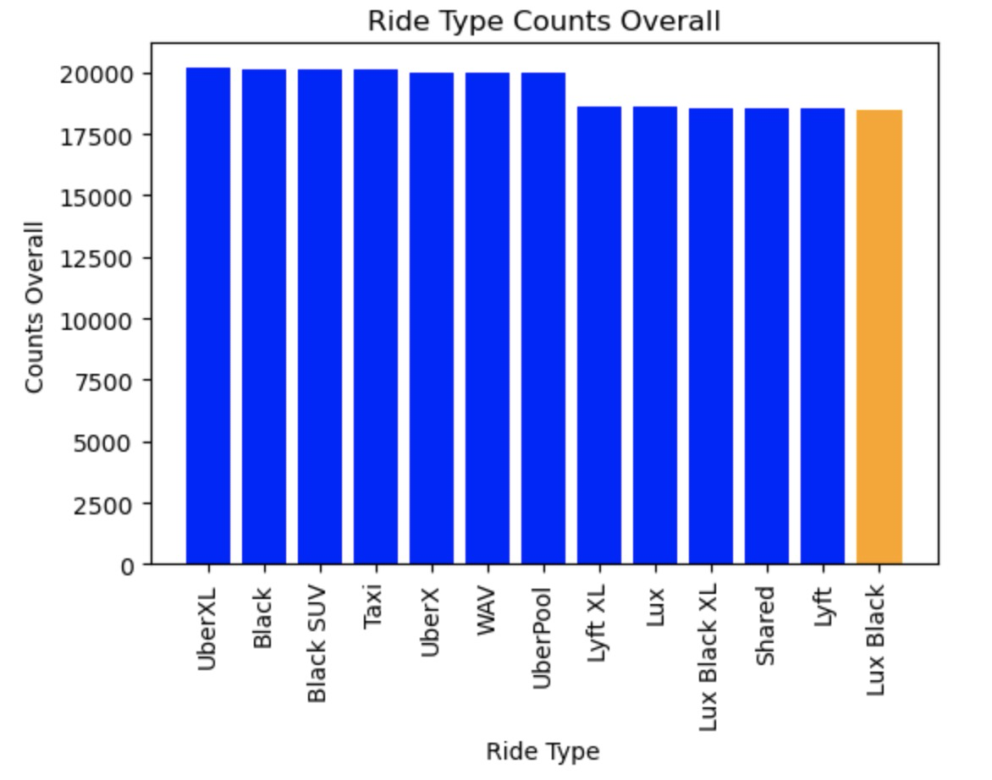
The Story of: Lux Black - [ HIGHLIGHT - 3 - Lux Black: $10.57 / mile ]
RIDE TYPE COUNTS OVERALL
1 - RIDE_TYPE NAME (UberXL): 20197
2 - RIDE_TYPE NAME (Black): 20125
3 - RIDE_TYPE NAME (Black SUV): 20109
4 - RIDE_TYPE NAME (Taxi): 20098
5 - RIDE_TYPE NAME (UberX): 19994
6 - RIDE_TYPE NAME (WAV): 19980
7 - RIDE_TYPE NAME (UberPool): 19963
8 - RIDE_TYPE NAME (Lyft XL): 18644
9 - RIDE_TYPE NAME (Lux): 18586
10 - RIDE_TYPE NAME (Lux Black XL): 18579
11 - RIDE_TYPE NAME (Shared): 18560
12 - RIDE_TYPE NAME (Lyft): 18534
13 - RIDE_TYPE NAME (Lux Black): 18458
TOTAL REVENUE by RIDE TYPE
1- Black SUV: $607,876.50
2- Lux Black XL: $600,229.50
3- Lux Black: $424,461.20
4- Black: $412,885.00
5- Lux: $330,299.00
6- UberXL: $316,497.50
7- Lyft XL: $285,467.10
8- WAV: $195,575.00
9- UberX: $195,537.00
10- Lyft: $178,235.35
11- UberPool: $174,393.00
12- Shared: $111,763.00
13- Taxi: $0.00
MEAN REVENUE by RIDE TYPE DISTANCE
1- Lux Black XL: $14.82 / mile
2- Black SUV: $13.89 / mile
3- Lux Black: $10.57 / mile
4- Black: $9.37 / mile
5- Lux: $8.14 / mile
6- UberXL: $7.16 / mile
7- Lyft XL: $7.01 / mile
8- WAV: $4.45 / mile
9- UberX: $4.48 / mile
10- Lyft: $4.40 / mile
11- UberPool: $4.01 / mile
12- Shared: $2.76 / mile
13- Taxi: $0.00 / mile

Slide 26
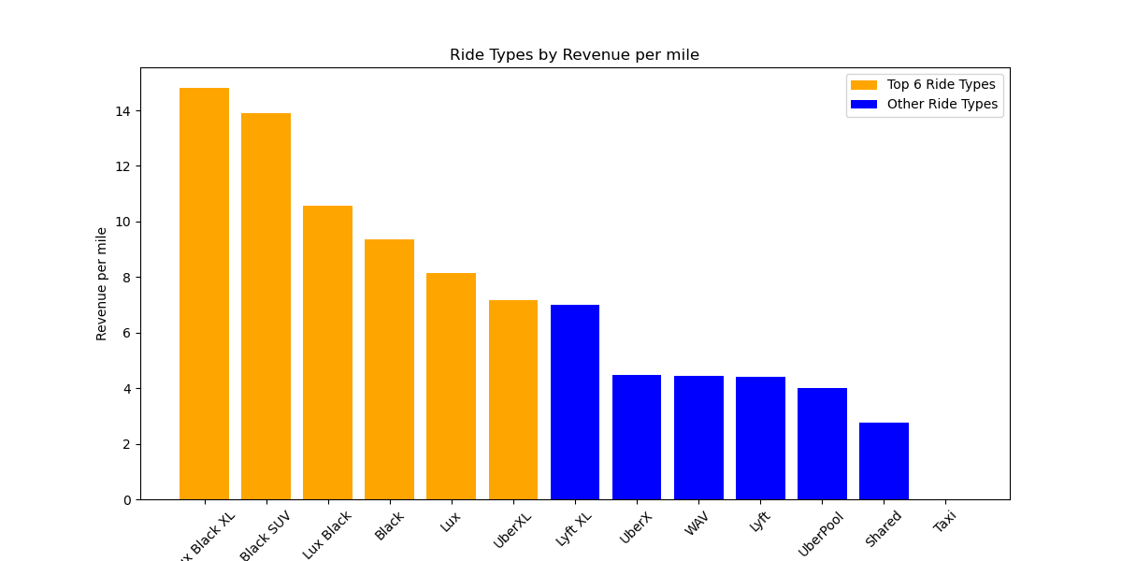
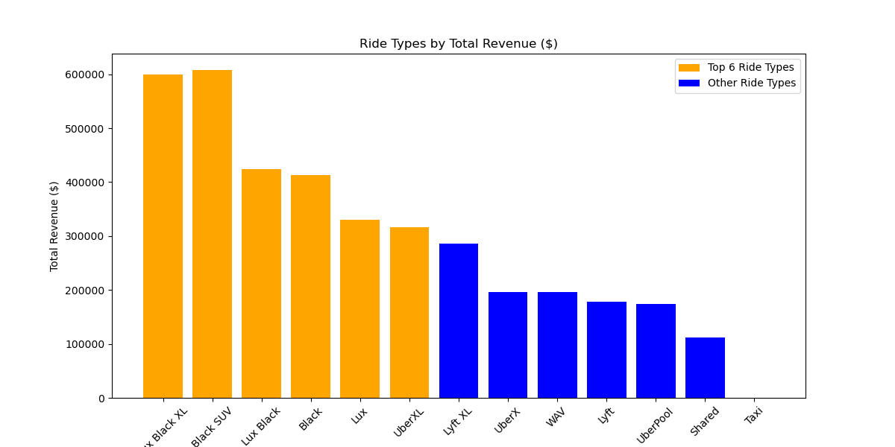
Insert analysis

Slide 27
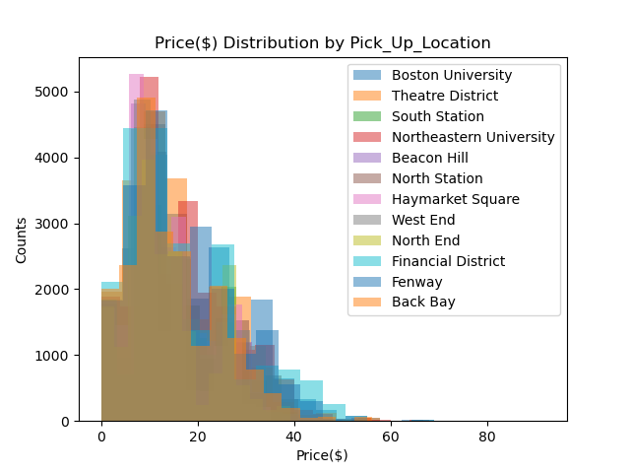
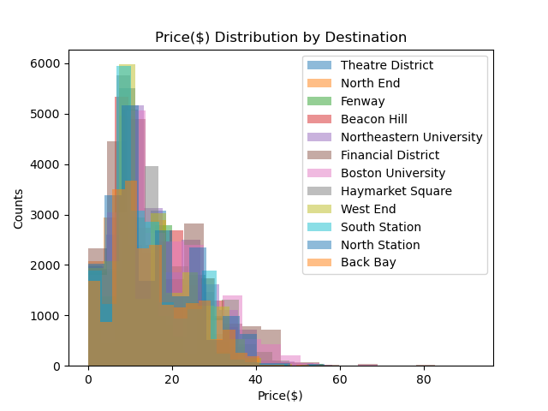
Analysis on distribution and p-values

Slide 28
Statistical Analysis

Slide 29
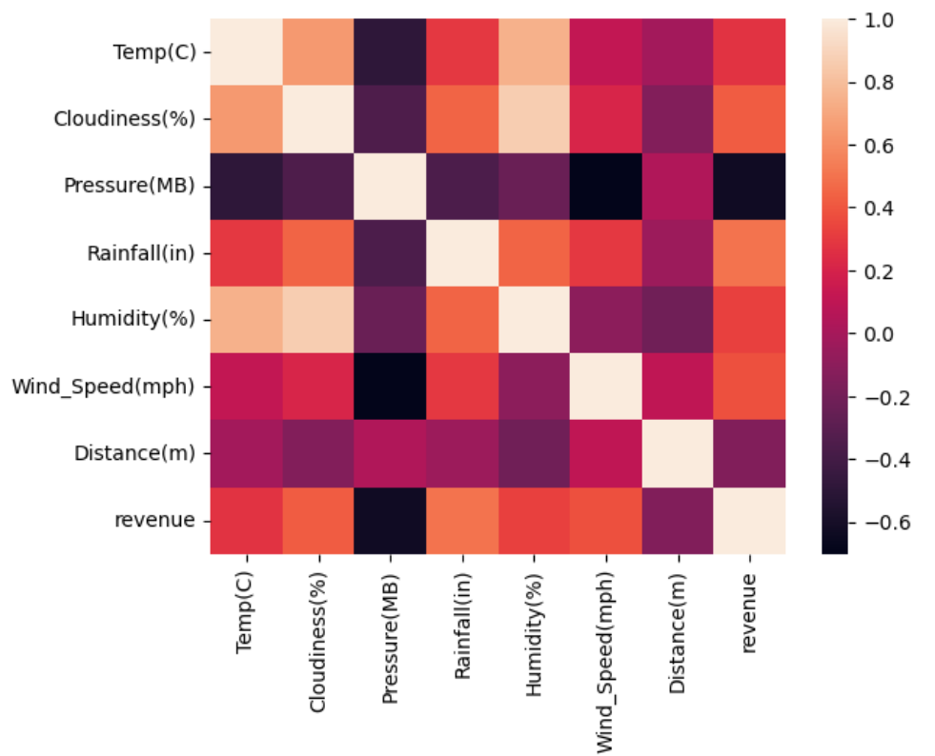
Rideshare and Weather Correlation Heatmaps
Rainfall exhibits the strongest correlation with revenue.
Weather conditions positively impact revenue.
Distance has a negative effect on revenue.
To increase revenue, the best strategy is to focus on providing more short distance rides.
Notes:
Data has been aggravated to plot the correlation of revenue based on average of weather conditions on different days of the data. Numbers above 0 have positive effect and below 0 negative effect.
Distance has the negative effect since bulk of the charges comes from initial charge on each ride. To increase Revenue based on Distance is better to keep the Distances short to increase Revenue.

Slide 30
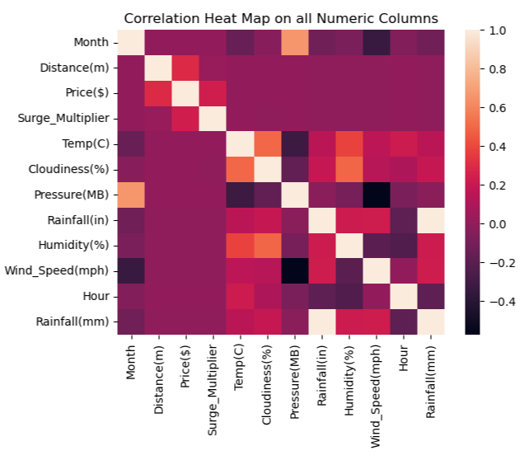
Distance Vs. Price
How can we determine the influence of distance on the price charges for each app?
Does distance not have an impact on ride fares?
Uber p-value =1.1480829994832444e-127
Lyft p-value = 4.858273627090331e-168
Result : The null hypothesis will be rejected due to the significant correlation between the small numbers, indicating that distance does indeed have an effect on price.

Slide 31
Our Best Hypothesis

Slide 32
What we Found
Uber has more customers and rides, but Lyft charges more per ride!
Lyft really monopolizes luxury rides, whereas Uber goes the distance. Literally! Rides travelling far mostly use Uber.
The weather has little to no effect on rideshare behavior! Although we know that when someone’s “under the weather”, Uber is the top pick! Be it windy or cloudy, rides are pretty consistent throughout. However with rain, most people seem to stick to shorter distances.
While shared rides go down on weekends, surge pricing goes up.
Distance can mean higher prices but Uber charges less per mile, hence relates to being the pick for rides >5miles
Ultimately *drum roll**
If you’re a driver, you earn more with Lyft
If you’re a commuter, you benefit more with Uber

Slide 33
Our Wins & Learnings
Cleaning Data is no joke!! Approximations helped us keep a lot of our data because there is rarely a lot of difference in weather in 15 min time gaps.
Ensure data types are set accordingly, and necessary columns are included in the beginning of your analysis.
Once data is grouped, initialize it! So you can call back to it when you’re running other functions and reduces the amount of individual groupings you have to do.
Dealing with outliers! Our data was not normally distributed, which resulted in a lot of outliers. Instead of trying to fix it, we looked back on what data points could potentially be missing, like number of riders per ride or rider sentiment/tips.
Next steps could be to,
See how rideshare is different now, or how COVID affected rideshare
Compare against newer rideshare apps like Scoop or Zipcar

Slide 34
(Uber vs Lyft Cab Prices)[https://www.kaggle.com/datasets/ravi72munde/uber-lyft-cab-prices] contains two csv files,
cab-rides.csv
Weather.csv
Title image : https://blog.shift.com/best-cars-uber-lyft/

Slide 35
/// divider - RIDE TYPE stories below ///

Slide 36
The Story of: Lux Black XL [ HIGHLIGHT - 1- Lux Black XL: $14.82 / mile ]
RIDE TYPE COUNTS OVERALL
1 - RIDE_TYPE NAME (UberXL): 20197
2 - RIDE_TYPE NAME (Black): 20125
3 - RIDE_TYPE NAME (Black SUV): 20109
4 - RIDE_TYPE NAME (Taxi): 20098
5 - RIDE_TYPE NAME (UberX): 19994
6 - RIDE_TYPE NAME (WAV): 19980
7 - RIDE_TYPE NAME (UberPool): 19963
8 - RIDE_TYPE NAME (Lyft XL): 18644
9 - RIDE_TYPE NAME (Lux): 18586
10 - RIDE_TYPE NAME (Lux Black XL): 18579
11 - RIDE_TYPE NAME (Shared): 18560
12 - RIDE_TYPE NAME (Lyft): 18534
13 - RIDE_TYPE NAME (Lux Black): 18458
TOTAL REVENUE by RIDE TYPE
1- Black SUV: $607,876.50
2- Lux Black XL: $600,229.50
3- Lux Black: $424,461.20
4- Black: $412,885.00
5- Lux: $330,299.00
6- UberXL: $316,497.50
7- Lyft XL: $285,467.10
8- WAV: $195,575.00
9- UberX: $195,537.00
10- Lyft: $178,235.35
11- UberPool: $174,393.00
12- Shared: $111,763.00
13- Taxi: $0.00
MEAN REVENUE by RIDE TYPE DISTANCE
1- Lux Black XL: $14.82 / mile
2- Black SUV: $13.89 / mile
3- Lux Black: $10.57 / mile
4- Black: $9.37 / mile
5- Lux: $8.14 / mile
6- UberXL: $7.16 / mile
7- Lyft XL: $7.01 / mile
8- WAV: $4.45 / mile
9- UberX: $4.48 / mile
10- Lyft: $4.40 / mile
11- UberPool: $4.01 / mile
12- Shared: $2.76 / mile
13- Taxi: $0.00 / mile

Slide 37
The Story of: BLACK SUV ( uber ) - [ HIGHLIGHT - 2 - Black SUV: $13.89 / mile ]
RIDE TYPE COUNTS OVERALL
1 - RIDE_TYPE NAME (UberXL): 20197
2 - RIDE_TYPE NAME (Black): 20125
3 - RIDE_TYPE NAME (Black SUV): 20109
4 - RIDE_TYPE NAME (Taxi): 20098
5 - RIDE_TYPE NAME (UberX): 19994
6 - RIDE_TYPE NAME (WAV): 19980
7 - RIDE_TYPE NAME (UberPool): 19963
8 - RIDE_TYPE NAME (Lyft XL): 18644
9 - RIDE_TYPE NAME (Lux): 18586
10 - RIDE_TYPE NAME (Lux Black XL): 18579
11 - RIDE_TYPE NAME (Shared): 18560
12 - RIDE_TYPE NAME (Lyft): 18534
13 - RIDE_TYPE NAME (Lux Black): 18458
TOTAL REVENUE by RIDE TYPE
1- Black SUV: $607,876.50
2- Lux Black XL: $600,229.50
3- Lux Black: $424,461.20
4- Black: $412,885.00
5- Lux: $330,299.00
6- UberXL: $316,497.50
7- Lyft XL: $285,467.10
8- WAV: $195,575.00
9- UberX: $195,537.00
10- Lyft: $178,235.35
11- UberPool: $174,393.00
12- Shared: $111,763.00
13- Taxi: $0.00
MEAN REVENUE by RIDE TYPE DISTANCE
1- Lux Black XL: $14.82 / mile
2- Black SUV: $13.89 / mile
3- Lux Black: $10.57 / mile
4- Black: $9.37 / mile
5- Lux: $8.14 / mile
6- UberXL: $7.16 / mile
7- Lyft XL: $7.01 / mile
8- WAV: $4.45 / mile
9- UberX: $4.48 / mile
10- Lyft: $4.40 / mile
11- UberPool: $4.01 / mile
12- Shared: $2.76 / mile
13- Taxi: $0.00 / mile

Slide 38
The Story of: Lux Black - [ HIGHLIGHT - 3 - Lux Black: $10.57 / mile ]
RIDE TYPE COUNTS OVERALL
1 - RIDE_TYPE NAME (UberXL): 20197
2 - RIDE_TYPE NAME (Black): 20125
3 - RIDE_TYPE NAME (Black SUV): 20109
4 - RIDE_TYPE NAME (Taxi): 20098
5 - RIDE_TYPE NAME (UberX): 19994
6 - RIDE_TYPE NAME (WAV): 19980
7 - RIDE_TYPE NAME (UberPool): 19963
8 - RIDE_TYPE NAME (Lyft XL): 18644
9 - RIDE_TYPE NAME (Lux): 18586
10 - RIDE_TYPE NAME (Lux Black XL): 18579
11 - RIDE_TYPE NAME (Shared): 18560
12 - RIDE_TYPE NAME (Lyft): 18534
13 - RIDE_TYPE NAME (Lux Black): 18458
TOTAL REVENUE by RIDE TYPE
1- Black SUV: $607,876.50
2- Lux Black XL: $600,229.50
3- Lux Black: $424,461.20
4- Black: $412,885.00
5- Lux: $330,299.00
6- UberXL: $316,497.50
7- Lyft XL: $285,467.10
8- WAV: $195,575.00
9- UberX: $195,537.00
10- Lyft: $178,235.35
11- UberPool: $174,393.00
12- Shared: $111,763.00
13- Taxi: $0.00
MEAN REVENUE by RIDE TYPE DISTANCE
1- Lux Black XL: $14.82 / mile
2- Black SUV: $13.89 / mile
3- Lux Black: $10.57 / mile
4- Black: $9.37 / mile
5- Lux: $8.14 / mile
6- UberXL: $7.16 / mile
7- Lyft XL: $7.01 / mile
8- WAV: $4.45 / mile
9- UberX: $4.48 / mile
10- Lyft: $4.40 / mile
11- UberPool: $4.01 / mile
12- Shared: $2.76 / mile
13- Taxi: $0.00 / mile

Slide 39
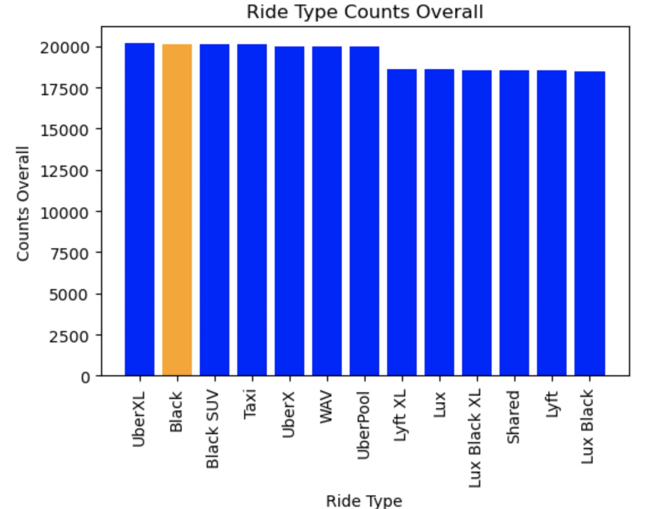
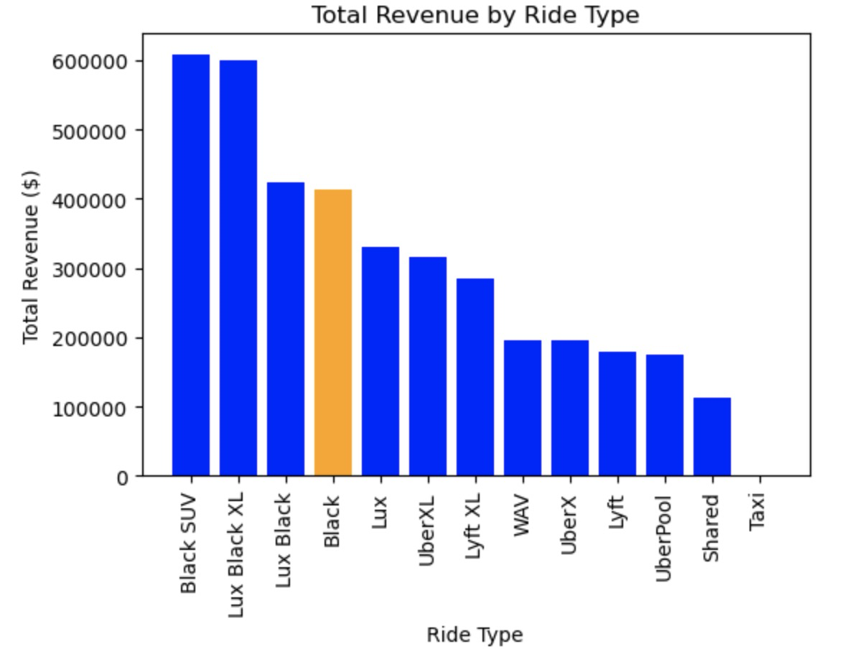
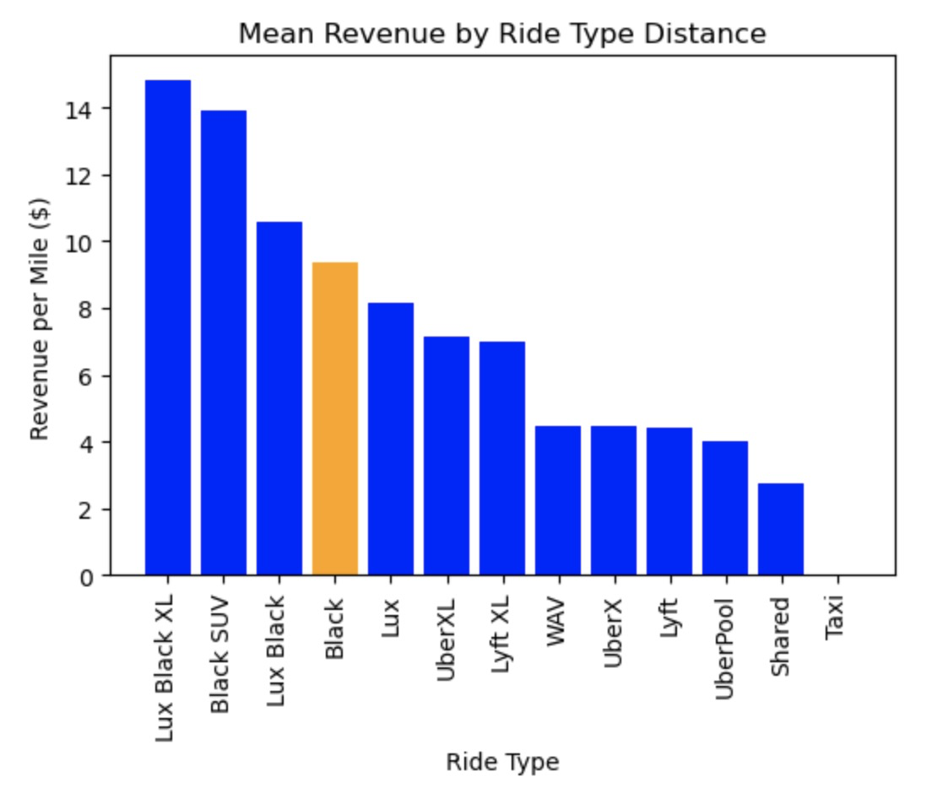
The Story of: BLACK ( uber )
RIDE TYPE COUNTS OVERALL
1 - RIDE_TYPE NAME (UberXL): 20197
2 - RIDE_TYPE NAME (Black): 20125
3 - RIDE_TYPE NAME (Black SUV): 20109
4 - RIDE_TYPE NAME (Taxi): 20098
5 - RIDE_TYPE NAME (UberX): 19994
6 - RIDE_TYPE NAME (WAV): 19980
7 - RIDE_TYPE NAME (UberPool): 19963
8 - RIDE_TYPE NAME (Lyft XL): 18644
9 - RIDE_TYPE NAME (Lux): 18586
10 - RIDE_TYPE NAME (Lux Black XL): 18579
11 - RIDE_TYPE NAME (Shared): 18560
12 - RIDE_TYPE NAME (Lyft): 18534
13 - RIDE_TYPE NAME (Lux Black): 18458
TOTAL REVENUE by RIDE TYPE
1- Black SUV: $607,876.50
2- Lux Black XL: $600,229.50
3- Lux Black: $424,461.20
4- Black: $412,885.00
5- Lux: $330,299.00
6- UberXL: $316,497.50
7- Lyft XL: $285,467.10
8- WAV: $195,575.00
9- UberX: $195,537.00
10- Lyft: $178,235.35
11- UberPool: $174,393.00
12- Shared: $111,763.00
13- Taxi: $0.00
MEAN REVENUE by RIDE TYPE DISTANCE
1- Lux Black XL: $14.82 / mile
2- Black SUV: $13.89 / mile
3- Lux Black: $10.57 / mile
4- Black: $9.37 / mile
5- Lux: $8.14 / mile
6- UberXL: $7.16 / mile
7- Lyft XL: $7.01 / mile
8- WAV: $4.45 / mile
9- UberX: $4.48 / mile
10- Lyft: $4.40 / mile
11- UberPool: $4.01 / mile
12- Shared: $2.76 / mile
13- Taxi: $0.00 / mile

Slide 40
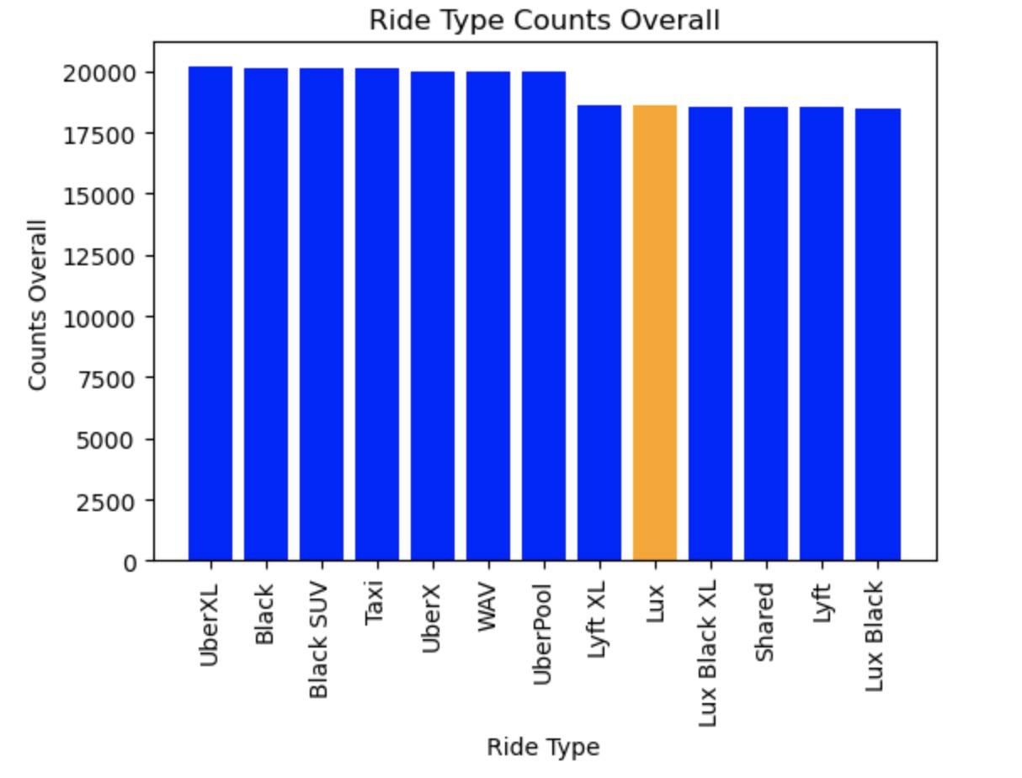
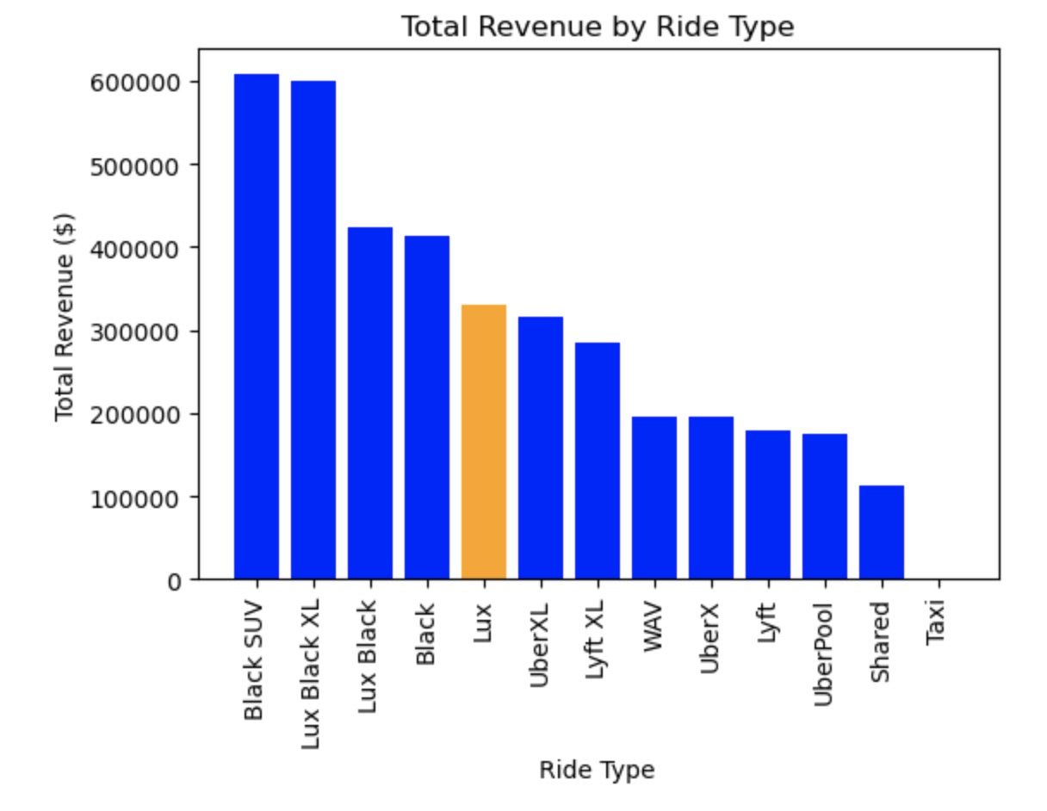

The Story of: Lux
RIDE TYPE COUNTS OVERALL
1 - RIDE_TYPE NAME (UberXL): 20197
2 - RIDE_TYPE NAME (Black): 20125
3 - RIDE_TYPE NAME (Black SUV): 20109
4 - RIDE_TYPE NAME (Taxi): 20098
5 - RIDE_TYPE NAME (UberX): 19994
6 - RIDE_TYPE NAME (WAV): 19980
7 - RIDE_TYPE NAME (UberPool): 19963
8 - RIDE_TYPE NAME (Lyft XL): 18644
9 - RIDE_TYPE NAME (Lux): 18586
10 - RIDE_TYPE NAME (Lux Black XL): 18579
11 - RIDE_TYPE NAME (Shared): 18560
12 - RIDE_TYPE NAME (Lyft): 18534
13 - RIDE_TYPE NAME (Lux Black): 18458
TOTAL REVENUE by RIDE TYPE
1- Black SUV: $607,876.50
2- Lux Black XL: $600,229.50
3- Lux Black: $424,461.20
4- Black: $412,885.00
5- Lux: $330,299.00
6- UberXL: $316,497.50
7- Lyft XL: $285,467.10
8- WAV: $195,575.00
9- UberX: $195,537.00
10- Lyft: $178,235.35
11- UberPool: $174,393.00
12- Shared: $111,763.00
13- Taxi: $0.00
MEAN REVENUE by RIDE TYPE DISTANCE
1- Lux Black XL: $14.82 / mile
2- Black SUV: $13.89 / mile
3- Lux Black: $10.57 / mile
4- Black: $9.37 / mile
5- Lux: $8.14 / mile
6- UberXL: $7.16 / mile
7- Lyft XL: $7.01 / mile
8- WAV: $4.45 / mile
9- UberX: $4.48 / mile
10- Lyft: $4.40 / mile
11- UberPool: $4.01 / mile
12- Shared: $2.76 / mile
13- Taxi: $0.00 / mile

Slide 41



The Story of: UBER XL - The Story of: UberXL - [ HIGHLIGHT - 6 - Uber XL: $7.16 / mile ]
RIDE TYPE COUNTS OVERALL
1 - RIDE_TYPE NAME (UberXL): 20197
2 - RIDE_TYPE NAME (Black): 20125
3 - RIDE_TYPE NAME (Black SUV): 20109
4 - RIDE_TYPE NAME (Taxi): 20098
5 - RIDE_TYPE NAME (UberX): 19994
6 - RIDE_TYPE NAME (WAV): 19980
7 - RIDE_TYPE NAME (UberPool): 19963
8 - RIDE_TYPE NAME (Lyft XL): 18644
9 - RIDE_TYPE NAME (Lux): 18586
10 - RIDE_TYPE NAME (Lux Black XL): 18579
11 - RIDE_TYPE NAME (Shared): 18560
12 - RIDE_TYPE NAME (Lyft): 18534
13 - RIDE_TYPE NAME (Lux Black): 18458
TOTAL REVENUE by RIDE TYPE
1- Black SUV: $607,876.50
2- Lux Black XL: $600,229.50
3- Lux Black: $424,461.20
4- Black: $412,885.00
5- Lux: $330,299.00
6- UberXL: $316,497.50
7- Lyft XL: $285,467.10
8- WAV: $195,575.00
9- UberX: $195,537.00
10- Lyft: $178,235.35
11- UberPool: $174,393.00
12- Shared: $111,763.00
13- Taxi: $0.00
MEAN REVENUE by RIDE TYPE DISTANCE
1- Lux Black XL: $14.82 / mile
2- Black SUV: $13.89 / mile
3- Lux Black: $10.57 / mile
4- Black: $9.37 / mile
5- Lux: $8.14 / mile
6- UberXL: $7.16 / mile
7- Lyft XL: $7.01 / mile
8- WAV: $4.45 / mile
9- UberX: $4.48 / mile
10- Lyft: $4.40 / mile
11- UberPool: $4.01 / mile
12- Shared: $2.76 / mile
13- Taxi: $0.00 / mile

Slide 42



The Story of: Lyft XL
RIDE TYPE COUNTS OVERALL
1 - RIDE_TYPE NAME (UberXL): 20197
2 - RIDE_TYPE NAME (Black): 20125
3 - RIDE_TYPE NAME (Black SUV): 20109
4 - RIDE_TYPE NAME (Taxi): 20098
5 - RIDE_TYPE NAME (UberX): 19994
6 - RIDE_TYPE NAME (WAV): 19980
7 - RIDE_TYPE NAME (UberPool): 19963
8 - RIDE_TYPE NAME (Lyft XL): 18644
9 - RIDE_TYPE NAME (Lux): 18586
10 - RIDE_TYPE NAME (Lux Black XL): 18579
11 - RIDE_TYPE NAME (Shared): 18560
12 - RIDE_TYPE NAME (Lyft): 18534
13 - RIDE_TYPE NAME (Lux Black): 18458
TOTAL REVENUE by RIDE TYPE
1- Black SUV: $607,876.50
2- Lux Black XL: $600,229.50
3- Lux Black: $424,461.20
4- Black: $412,885.00
5- Lux: $330,299.00
6- UberXL: $316,497.50
7- Lyft XL: $285,467.10
8- WAV: $195,575.00
9- UberX: $195,537.00
10- Lyft: $178,235.35
11- UberPool: $174,393.00
12- Shared: $111,763.00
13- Taxi: $0.00
MEAN REVENUE by RIDE TYPE DISTANCE
1- Lux Black XL: $14.82 / mile
2- Black SUV: $13.89 / mile
3- Lux Black: $10.57 / mile
4- Black: $9.37 / mile
5- Lux: $8.14 / mile
6- UberXL: $7.16 / mile
7- Lyft XL: $7.01 / mile
8- WAV: $4.45 / mile
9- UberX: $4.48 / mile
10- Lyft: $4.40 / mile
11- UberPool: $4.01 / mile
12- Shared: $2.76 / mile
13- Taxi: $0.00 / mile

Slide 43



The Story of: WAV
RIDE TYPE COUNTS OVERALL
1 - RIDE_TYPE NAME (UberXL): 20197
2 - RIDE_TYPE NAME (Black): 20125
3 - RIDE_TYPE NAME (Black SUV): 20109
4 - RIDE_TYPE NAME (Taxi): 20098
5 - RIDE_TYPE NAME (UberX): 19994
6 - RIDE_TYPE NAME (WAV): 19980
7 - RIDE_TYPE NAME (UberPool): 19963
8 - RIDE_TYPE NAME (Lyft XL): 18644
9 - RIDE_TYPE NAME (Lux): 18586
10 - RIDE_TYPE NAME (Lux Black XL): 18579
11 - RIDE_TYPE NAME (Shared): 18560
12 - RIDE_TYPE NAME (Lyft): 18534
13 - RIDE_TYPE NAME (Lux Black): 18458
TOTAL REVENUE by RIDE TYPE
1- Black SUV: $607,876.50
2- Lux Black XL: $600,229.50
3- Lux Black: $424,461.20
4- Black: $412,885.00
5- Lux: $330,299.00
6- UberXL: $316,497.50
7- Lyft XL: $285,467.10
8- WAV: $195,575.00
9- UberX: $195,537.00
10- Lyft: $178,235.35
11- UberPool: $174,393.00
12- Shared: $111,763.00
13- Taxi: $0.00
MEAN REVENUE by RIDE TYPE DISTANCE
1- Lux Black XL: $14.82 / mile
2- Black SUV: $13.89 / mile
3- Lux Black: $10.57 / mile
4- Black: $9.37 / mile
5- Lux: $8.14 / mile
6- UberXL: $7.16 / mile
7- Lyft XL: $7.01 / mile
8- WAV: $4.45 / mile
9- UberX: $4.48 / mile
10- Lyft: $4.40 / mile
11- UberPool: $4.01 / mile
12- Shared: $2.76 / mile
13- Taxi: $0.00 / mile

Slide 44



The Story of: UBER X
RIDE TYPE COUNTS OVERALL
1 - RIDE_TYPE NAME (UberXL): 20197
2 - RIDE_TYPE NAME (Black): 20125
3 - RIDE_TYPE NAME (Black SUV): 20109
4 - RIDE_TYPE NAME (Taxi): 20098
5 - RIDE_TYPE NAME (UberX): 19994
6 - RIDE_TYPE NAME (WAV): 19980
7 - RIDE_TYPE NAME (UberPool): 19963
8 - RIDE_TYPE NAME (Lyft XL): 18644
9 - RIDE_TYPE NAME (Lux): 18586
10 - RIDE_TYPE NAME (Lux Black XL): 18579
11 - RIDE_TYPE NAME (Shared): 18560
12 - RIDE_TYPE NAME (Lyft): 18534
13 - RIDE_TYPE NAME (Lux Black): 18458
TOTAL REVENUE by RIDE TYPE
1- Black SUV: $607,876.50
2- Lux Black XL: $600,229.50
3- Lux Black: $424,461.20
4- Black: $412,885.00
5- Lux: $330,299.00
6- UberXL: $316,497.50
7- Lyft XL: $285,467.10
8- WAV: $195,575.00
9- UberX: $195,537.00
10- Lyft: $178,235.35
11- UberPool: $174,393.00
12- Shared: $111,763.00
13- Taxi: $0.00
MEAN REVENUE by RIDE TYPE DISTANCE
1- Lux Black XL: $14.82 / mile
2- Black SUV: $13.89 / mile
3- Lux Black: $10.57 / mile
4- Black: $9.37 / mile
5- Lux: $8.14 / mile
6- UberXL: $7.16 / mile
7- Lyft XL: $7.01 / mile
8- WAV: $4.45 / mile
9- UberX: $4.48 / mile
10- Lyft: $4.40 / mile
11- UberPool: $4.01 / mile
12- Shared: $2.76 / mile
13- Taxi: $0.00 / mile

Slide 45



The Story of: Lyft
RIDE TYPE COUNTS OVERALL
1 - RIDE_TYPE NAME (UberXL): 20197
2 - RIDE_TYPE NAME (Black): 20125
3 - RIDE_TYPE NAME (Black SUV): 20109
4 - RIDE_TYPE NAME (Taxi): 20098
5 - RIDE_TYPE NAME (UberX): 19994
6 - RIDE_TYPE NAME (WAV): 19980
7 - RIDE_TYPE NAME (UberPool): 19963
8 - RIDE_TYPE NAME (Lyft XL): 18644
9 - RIDE_TYPE NAME (Lux): 18586
10 - RIDE_TYPE NAME (Lux Black XL): 18579
11 - RIDE_TYPE NAME (Shared): 18560
12 - RIDE_TYPE NAME (Lyft): 18534
13 - RIDE_TYPE NAME (Lux Black): 18458
TOTAL REVENUE by RIDE TYPE
1- Black SUV: $607,876.50
2- Lux Black XL: $600,229.50
3- Lux Black: $424,461.20
4- Black: $412,885.00
5- Lux: $330,299.00
6- UberXL: $316,497.50
7- Lyft XL: $285,467.10
8- WAV: $195,575.00
9- UberX: $195,537.00
10- Lyft: $178,235.35
11- UberPool: $174,393.00
12- Shared: $111,763.00
13- Taxi: $0.00
MEAN REVENUE by RIDE TYPE DISTANCE
1- Lux Black XL: $14.82 / mile
2- Black SUV: $13.89 / mile
3- Lux Black: $10.57 / mile
4- Black: $9.37 / mile
5- Lux: $8.14 / mile
6- UberXL: $7.16 / mile
7- Lyft XL: $7.01 / mile
8- WAV: $4.45 / mile
9- UberX: $4.48 / mile
10- Lyft: $4.40 / mile
11- UberPool: $4.01 / mile
12- Shared: $2.76 / mile
13- Taxi: $0.00 / mile

Slide 46



The Story of: UberPool
RIDE TYPE COUNTS OVERALL
1 - RIDE_TYPE NAME (UberXL): 20197
2 - RIDE_TYPE NAME (Black): 20125
3 - RIDE_TYPE NAME (Black SUV): 20109
4 - RIDE_TYPE NAME (Taxi): 20098
5 - RIDE_TYPE NAME (UberX): 19994
6 - RIDE_TYPE NAME (WAV): 19980
7 - RIDE_TYPE NAME (UberPool): 19963
8 - RIDE_TYPE NAME (Lyft XL): 18644
9 - RIDE_TYPE NAME (Lux): 18586
10 - RIDE_TYPE NAME (Lux Black XL): 18579
11 - RIDE_TYPE NAME (Shared): 18560
12 - RIDE_TYPE NAME (Lyft): 18534
13 - RIDE_TYPE NAME (Lux Black): 18458
TOTAL REVENUE by RIDE TYPE
1- Black SUV: $607,876.50
2- Lux Black XL: $600,229.50
3- Lux Black: $424,461.20
4- Black: $412,885.00
5- Lux: $330,299.00
6- UberXL: $316,497.50
7- Lyft XL: $285,467.10
8- WAV: $195,575.00
9- UberX: $195,537.00
10- Lyft: $178,235.35
11- UberPool: $174,393.00
12- Shared: $111,763.00
13- Taxi: $0.00
MEAN REVENUE by RIDE TYPE DISTANCE
1- Lux Black XL: $14.82 / mile
2- Black SUV: $13.89 / mile
3- Lux Black: $10.57 / mile
4- Black: $9.37 / mile
5- Lux: $8.14 / mile
6- UberXL: $7.16 / mile
7- Lyft XL: $7.01 / mile
8- WAV: $4.45 / mile
9- UberX: $4.48 / mile
10- Lyft: $4.40 / mile
11- UberPool: $4.01 / mile
12- Shared: $2.76 / mile
13- Taxi: $0.00 / mile

Slide 47



The Story of: Shared
RIDE TYPE COUNTS OVERALL
1 - RIDE_TYPE NAME (UberXL): 20197
2 - RIDE_TYPE NAME (Black): 20125
3 - RIDE_TYPE NAME (Black SUV): 20109
4 - RIDE_TYPE NAME (Taxi): 20098
5 - RIDE_TYPE NAME (UberX): 19994
6 - RIDE_TYPE NAME (WAV): 19980
7 - RIDE_TYPE NAME (UberPool): 19963
8 - RIDE_TYPE NAME (Lyft XL): 18644
9 - RIDE_TYPE NAME (Lux): 18586
10 - RIDE_TYPE NAME (Lux Black XL): 18579
11 - RIDE_TYPE NAME (Shared): 18560
12 - RIDE_TYPE NAME (Lyft): 18534
13 - RIDE_TYPE NAME (Lux Black): 18458
TOTAL REVENUE by RIDE TYPE
1- Black SUV: $607,876.50
2- Lux Black XL: $600,229.50
3- Lux Black: $424,461.20
4- Black: $412,885.00
5- Lux: $330,299.00
6- UberXL: $316,497.50
7- Lyft XL: $285,467.10
8- WAV: $195,575.00
9- UberX: $195,537.00
10- Lyft: $178,235.35
11- UberPool: $174,393.00
12- Shared: $111,763.00
13- Taxi: $0.00
MEAN REVENUE by RIDE TYPE DISTANCE
1- Lux Black XL: $14.82 / mile
2- Black SUV: $13.89 / mile
3- Lux Black: $10.57 / mile
4- Black: $9.37 / mile
5- Lux: $8.14 / mile
6- UberXL: $7.16 / mile
7- Lyft XL: $7.01 / mile
8- WAV: $4.45 / mile
9- UberX: $4.48 / mile
10- Lyft: $4.40 / mile
11- UberPool: $4.01 / mile
12- Shared: $2.76 / mile
13- Taxi: $0.00 / mile

